Slide 1
Hibatűrő rendszerek tervezési mintái
Autonóm és hibatűrő információs rendszerek
Kocsis Imre
ikocsis@mit.bme.hu
2013.10.21.

Slide 2
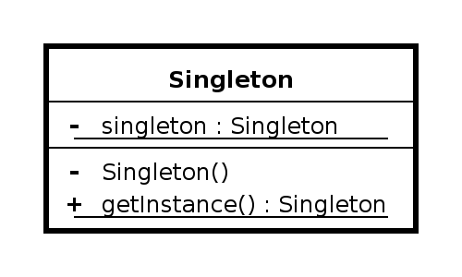
Ismétlés: singleton

Slide 3
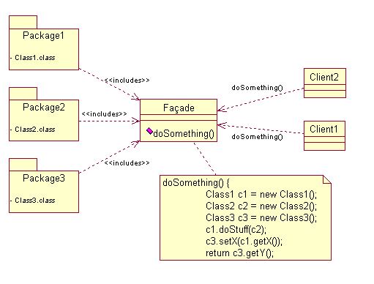
Ismétlés: Facade

Slide 4
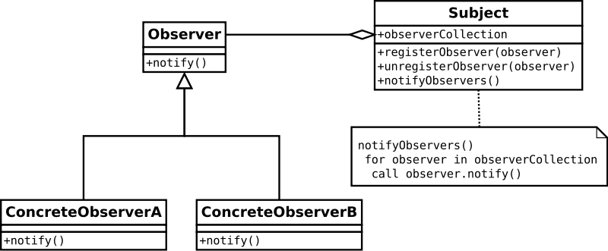
Ismétlés: Observer

Slide 5
Architekturális mintanyelv

Slide 6
Units of Mitigation
How can you keep the whole system from being unavailable when an error occurs?
„Design the system into parts that will contain both any errors and the error recovery. Choose the divisions that make sense for your system. Design the rest of the system around these parts that represent the basic units of error mitigation.”

Slide 7
Units of Mitigation
Division:
Architecture
Available recovery/mitigation techniques
…
Desirable: fail-silent
Example: three-tiered system, tier as unit
In-tier redundancy schemes…
… or request queuing
Some further problems:
How to process errors inside?
What should the blocks be?
Note: rough-grained pattern (HW and SW blocks)

Slide 8
Architekturális mintanyelv

Slide 9
Correcting Audits
Faulty data causes errors.
„Detect and correct data errors as soon as possible. Check related data for errors, correct and record the occurence of the error.”
Leads to a host of other patterns

Slide 10
Architekturális mintanyelv

Slide 11
Redundancy
Assumption: error processing usually stops normal execution
How can we reduce the amount of time between error detection and the resumption of normal operation after error recovery?
„Provide redundant capabilities that support quick activation to enable error processing to continue in parallel with normal execution.”

Slide 12
Architekturális mintanyelv

Slide 13
Someone in Charge
Anything can go wrong, even during error processing. When this happens the system might stop doing the error processing in addition to not doing the normal processing.
„All fault tolerance related activities have some component of the system that is clearly in charge and has the ability to determine correct completion and the responsibility to take action if it does not complete correctly.”

Slide 14
Someone in Charge
N.B. does not promote a global SPOF
On the contrary, see escalation
Example (Action / In Charge):
Checkpoint / each task
Rollback and roll forward / component R
Load shedding / component S
Also: voting / leader selection techniques

Slide 15
Architekturális mintanyelv

Slide 16
Minimize Human Intervention
How can we prevent people from doing the wrong things and causing errors?
„Design the system in a way that it is able to process and resolve errors automatically, before they become failures. This speeds error recovery and reduces the risk of procedural errors.”

Slide 17
Minimize Human Intervention
How?
Make sure all errors are reported to the Fault Observer
Indiv. components do not talk to the outside world
Concentrate output and input
Design automatic F/E/F, detection, processing, treatment

Slide 18
Architekturális mintanyelv

Slide 19
Maximize Human Participation
Should the system ignore people totally? That will reduce procedural errors.
„Know the user and their availability. Design the system to enable knowledgeable operating personnel to participate. […] Provide appropriate Maintenance Interfaces and Fault Observer capabilities […]”

Slide 20
Architekturális mintanyelv

Slide 21
Escalation
What does the system do when its attempt to process an error in a component is not acheiving the correct effect?
„When recovery or mitigation is failing, escalate the action to the next more drastic action.”

Slide 22
Architekturális mintanyelv

Slide 23
Fault Observer
Coordinate reporting to all observers that a fault is present, reported, and recovery actions escalated.

Slide 24
Architekturális mintanyelv

Slide 25
Maintenance Interface
Should maintenance and application requests be intermingled on the application input and output channels?
„Provide a separate interface to the system for the (almost) exclusive use of maintenance interactions.”

Slide 26
Detektálási minták

Slide 27
Fault Correlation
Hol találkoztunk ezzel korábban?
Mit jelentett a korreláció?
Példák?
Figyelem: ez egy nagy terület, a minta csak a szükségességéről beszél (~ „kell diagnosztika”)
Topológia-alapú megközelítések
Dinamikus modellezés: automaták, nyelvek
Statikus modellezés: terjedési relációk
Tanuló módszerek
…
Diagnosztika-elmélet: később

Slide 28
Fault Correlation
What fault is activating?
„Look at the unique signature of the error to sort it into the fault category for which error processing steps are known.”

Slide 29
Fault correlation
Gyakorlat-féle: adott egy topológia (DAG) és a szolgáltatási szintű hibahatások helyei. Lehetséges hibaok-helyek halmaza…?
Algoritmus?
Komplexitás?
Véges automata hibahelyekkel és mondat „hibás kimenettel”. Melyik (hibás) állapotokat érinthettük?

Slide 30
Mi a közös bennük?
„Bus Guardian” TT architektúrákban
Try/catch blokk
Desktop vírusvédelem

Slide 31
Detektálási minták

Slide 32
Error Containment Barrier
What is the first thing that the system must do when it detects an error?
„Isolate the error to a unit of mitigation. Stop the error flow with a barrier, quarantine and initiate either error recovery or error mitigation.”

Slide 33
Detektálási minták

Slide 34
Complete parameter checking
How can the time from fault activation to error detection be minimized?
„Perform frequent checks on data and operations to detect errors quickly and prevent errors from propagating to the rest of the system.”
More specifically, check all the inputs and parameters rigorously.
Level/granularity: design decision

Slide 35
Complete parameter checking
Hogyan ellenőrizzük ezt?
A = B / C ;
Notes:
Approrpriate ranges for A and B
A is a valid receiver
strict typing
no overflow and no underflow

Slide 36
Detektálási minták

Slide 37
System Monitor
How does one part of a system keep track that another part is alive and functioning?
„Create a Monitor to study system behavior, or the behavior of specific parts of the system to make sure that they continue operating correctly. When the watched components stop, the monitor should report the occurence to the Fault Observer and initiate corrective actions.”

Slide 38
System Monitor
Célja alapvetően a rendszerszinten manifesztálódó hibás állapotok felderítése.
A „hogyan” mind a detektálás, mind a javítás esetében nyitva marad, persze.

Slide 39
Detektálási minták

Slide 40
Hogyan nézzük meg, hogy egy szolgáltatás működik-e?
Potenciális problémák pl.:
„ritkás” munkavégzés
normál működés más csatornán zajlik

Slide 41
Heartbeat
How does the System Monitor know that a particular monitored task is still working?
„The System Monitor should see a periodic heartbeat from the monitored task. If the monitored task does not supply a heartbeat response within the required time then recovery action should be taken.”
Variants: autonomous / request-response
Végül is ez is heartbeat ebben az értelemben:

Slide 42
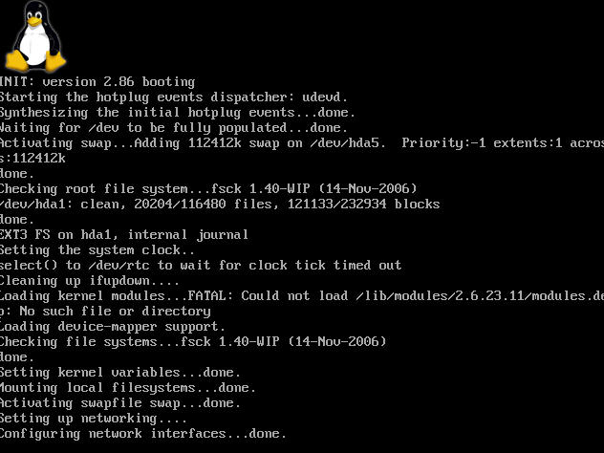

Slide 43
Detektálási minták

Slide 44
Acknowledgement
When there is a dialog between two tasks, what’s the easiest way for one task to determine that the other task is alive and functioning?
„Send an acknowledgement for all requests. All requests should require a reply to acknowledge receipt and to indicate that the monitored system is alive and able to adhere to the protocol. […]”

Slide 45
Acknowledgement
Hasznos minta, de ésszel alkalmazandó. Mikor ellenjavallott?

Slide 46
Detektálási minták

Slide 47
Realistic Threshold
How much time should elapse before the System Monitor takes action when an error is detected?
Why can this be a problem?
Terminology
Messaging latency
Detecion latency

Slide 48
Realistic Treshold
„Set the messaging latency based upon the worst case communications time combined with the time required to process one Heartbeat message.
Set the detection latency based upon the criticality of the functionality. Make it a multiple of the messaging latency.
Set them so that the availability requirement is met, yet false triggers do not occur.” (restart time!)

Slide 49
Detektálási minták

Slide 50
Existing Metrics
How to measure the severity of an overload without contributing to the overload?
„Use pre-existing indicators already tied to the resource as an indicator of the system’s overload condition.”
Példa?

Slide 51
Detektálási minták

Slide 52
Routine Maintenance
How can we keep preventable errors from occuring?
„Perform routine, preventive maintenance on the system.”

Slide 53
Routine Maintenance
Some applicable patterns:
Routine Audits, Routine Exercises
Deferrable Work
From the practical point of view:
HW
Software: garbage collection, rejuvenation, patching/updates is bizonyos értelemben
Data
Maintenance windows!

Slide 54
Detektálási minták

Slide 55
Routine Exercises
How do you know that Redundant elements that will be called into service by a Failover in case of an error or failure will actually work?
„Routinely exercise, or execute the system components that will be required in an error situation. This will identify latent faults.”

Slide 56
Detektálási minták

Slide 57
Riding over Transients
How can the system avoid wasting resources processing transient errors that won’t have a long term effect on the system?
„Monitor the system and conduct Fault Correlation. If the correlation indicates a transient fault, monitor the frequency of occurence, but take no action (unless treshold reached).”

Slide 58
Detektálási minták
Néhány minta explicit tárgyalásától eltekintettünk.

Slide 59
Helyreállítási (error recovery) minták

Slide 60
Quarantine
How can the system prevent errors from spreading?
„Establish a barrier around the element that prevents it from both contributing to the useful work and also prevents it from propagating its error into other parts of the system.”
Examples?
Desktop virus scanners, Intel vPro, BME intranet, spacecrafts ☺

Slide 61
Helyreállítási minták

Slide 62
Concentrated recovery
When processing an error, how should the system minimize unavailability?
„Focus all necessary resources on the recovery task so that the recovery time can be minimized.”
Also reduces risk
Needs proper selection of Units of Mitigation

Slide 63
Helyreállítási minták

Slide 64
Error Handler
Developing and maintaining application code is complicated by the need to process errors.
„Separate error processing code in special handling blocks for easier maintenance.”
(Java) exceptions!

Slide 65
Helyreállítási minták

Slide 66
Restart
How can execution resume when recovery from the error is not possible?
„Restart the system. Suffer the loss of time and state to reinitialize and restart the application from beginning.”

Slide 67
Restart
Általában több szintje értelmezhető, pl.
cold/warm
kiszolgáló / taszk (konténer)
Együtt járó minták:
eszkaláció után,
felelős által végezve,
koncentrált helyreállítás részeként,
hiba-megfigyelőnek jelentve,
rendszermonitor által megfigyelve
Követheti checkpoint-hoz visszatérés

Slide 68
Rollback
Where should processing resume after error recovery?
„Return to a point where processing can be synchronized that is before the point of error.”
Needs checkpoint + stable request log

Slide 69
Roll-forward
Where should processing resume after error recovery?
„Advance to the next point where the processing across the system can be synchronized. Do not resume execution from the point of error; continue as though the erroneous actions did not complete (or did complete successfully).”
System state: would have been encountered without the error.

Slide 70
Return to Reference Point
Where can execution resume when an error occurs that can be recovered, but for which the recovery does not provide appropriate Rollback/Roll-forward places?
„Resume execution at a point that is known to be safe.”
„Safe place” created at design time

Slide 71
Failover
The active part of a group of redundant elements has a fault; how can error-free execution continue?
„Switch system execution from the current active element to a redundant element.”

Slide 72
Helyreállítási minták

Slide 73
Checkpoint
Work in progress might be lost during the recovery from an error.
„Save state periodically. Build in the capability to restore the system to the same state that was saved, without having to recreate the entire execution from startup to the point of the saved state.”
Frequency/timing: tradeoff

Slide 74
Remote Storage
What storage location should be used for checkpoints to reduce the time before execution can be resumed after error recovery?
„Store the saved checkpoints in a centrally accessible location. This enables a new processor to access the saved checkpoint which minimizes the period of unavailability.”
Examples?

Slide 75
Hibakezelés (Error mitigation)
Hibás állapot maszkolása
Hatás-kompenzáció
Leginkább a túlterhelődés kezelése
Külső kérések
Hibák hatására kieső erőforrások!
Virtualizáció/cloud?

Slide 76
Hibakezelés (Error Mitigation)

Slide 77
Overload Toolboxes
How should the system handle situations of overload?
„Have multiple toolboxes with which to mitigate overloads. Avoid grouping of all the possible techniques together.”
Emlékezzünk vissza a detektálásra!

Slide 78
Hibakezelés (Error Mitigation)

Slide 79
Deferrable Work
What work should the system shed when the choices are handling most of the incoming work or the routine maintenance workload?
„Make the routine work deferrable.”
Valószínűleg a rendszer és perfiériája működik, különben honnan jönne a munkaterhelés...

Slide 80
Hibakezelés (Error Mitigation)

Slide 81
Reassess Overload Decision
What should the system do when the workload mitigation techniques are not working?
„Provide the system with a feedback loop which provides information to enable the system to reexamin fault correlation decisions.”
Ha működő „Shed Load”/... mellett is túlterhelt a rendszer, a hiba máshol (is) van

Slide 82
Hibakezelés (Error Mitigation)

Slide 83
Equitable resource allocation
How should requests for scarce resources be handled?
„Pool all similar requests and allocate resources to the pools based upon their availability and priority.”

Slide 84
Hibakezelés (Error Mitigation)

Slide 85
Queue for resources
What should be done with requests for resources that cannot be handled immediately when they arrive?
„Store requests for service that cannot be handled immediately in a queue.”
A sor lehetőleg véges hosszúságú legyen

Slide 86
Hibakezelés (Error Mitigation)

Slide 87
Expansive Automatic Controls
How can we avoid both the wasted effort processing the requests that can’t immediately be handled in an overload and at the same time increase overall request completions?
„Design some resources into the system that will be used only in case of overload. Provide new ways for the system to do its work that either uses reserved or fewer resources.”

Slide 88
Hibakezelés (Error Mitigation)

Slide 89
Protective Automatic Controls
What actions should an overloaded system take to avoid spending all of its time doing overhead work associated with new requests arriving?
„Automatically impose restrictions on how much work the system accepts to protect the system’s ability to function.”
A „tartalékkapacitás” függvényében

Slide 90
Hibakezelés (Error Mitigation)

Slide 91
Shed Load
How can the system best handle too many requests and keep them from overwhelming the system?
„Shed some requests so that the others may receive good service.”
Áteresztőképesség ← → Rendelkezésre állás

Slide 92
Hibakezelés (Error Mitigation)

Slide 93
Final Handling
How can the system best handle too many requests and keep them from overwhelming the system?
„Integrate the release of resources for internally terminated transactions with the usual release of resources done by normal task termination.”
Mikroszinten: „finally” blokk

Slide 94
Hibakezelés (Error Mitigation)

Slide 95
Share the Load
How can you increase the available processing power?
„Move some of the work to other processors. Move work that does not require high levels of synchronization.”
Cloud és virtualizált rendszerek!

Slide 96
Hibakezelés (Error Mitigation)

Slide 97
Shed Work at Periphery
How does the system shed load that is beyond system capacity for the lowest additional effort?
„Detect which work is eligible for shedding as close to the edges of the system as possible. Provide this detection mechanism with information about the processing capacity of the most limiting part of the system.”
Műszakilag nem triviális

Slide 98
Hibakezelés (Error Mitigation)

Slide 99
Slow it Down
How does the system shed load that is beyond system capacity for the lowest additional effort?
„Detect which work is eligible for shedding as close to the edges of the system as possible. Provide this detection mechanism with information about the processing capacity of the most limiting part of the system.”
Műszakilag nem triviális

