Slide 1
Bitcoin
Blockchain Technologies and Applications
Imre Kocsis, ikocsis@mit.bme.hu
2019.02.14

Slide 2

?

Slide 3
The many interpretations of Bitcoin
CBDC driver
Mother of all DLTs
Risky commodity
Waste of energy
Integration of known techniques
Vehicle of
illegal activities
Embodiment of cryptoanarchy
Payment nw
Cryptocurrency
Ledger
P2P network
Software

Slide 4
The Story
(its beginning, At Least)

Slide 5
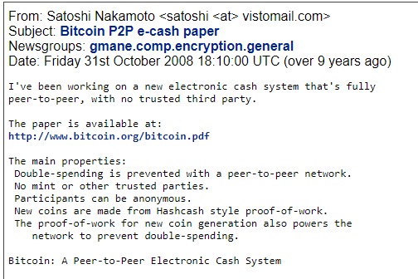
The start
Reference implementation: next January

Slide 6
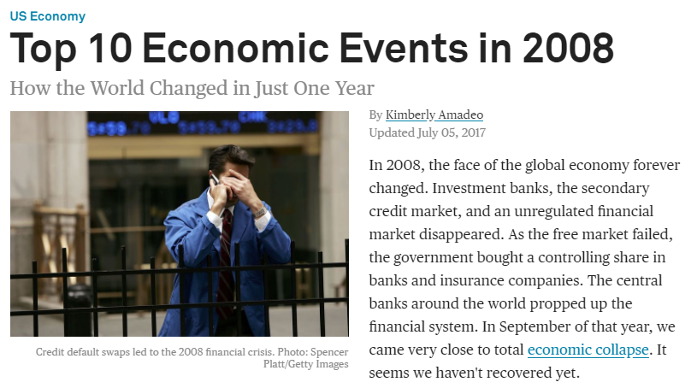
The backdrop
FED “shores up” financial system
Bailouts all around
AIG nationalized
Markets crash/freeze
…
Source: https://www.thebalance.com/top-ten-economic-issues-in-2008-year-in-review-3305686

Slide 7
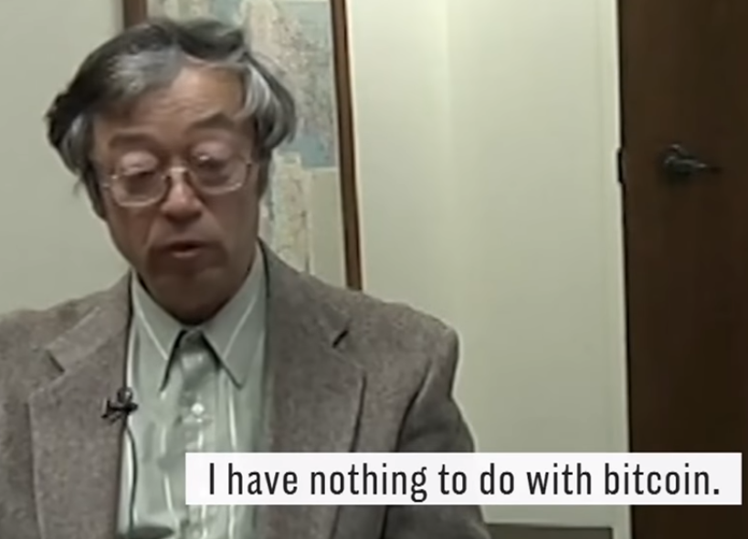
Who is Satoshi Nakamoto?
Basically: we don’t know
2011: “I have moved on to other things.”
This means no BDFL
  The Bitcoin Foundation
  + some exciting infighting
Figure: https://www.youtube.com/watch?v=Bze53qwHS8o
See also: https://web.archive.org/web/20160821154511/http://www.economist.com/blogs/economist-explains/2015/11/economist-explains-1

Slide 8
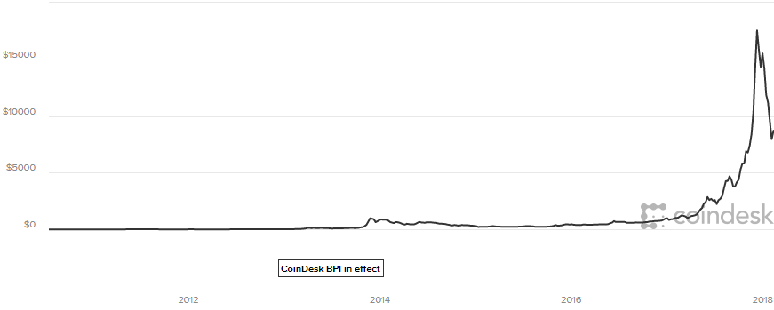
The hype in numbers
?
Mainstreaming, “big money”, derivatives…
China?
Hyperledger
Silk road crackdown
Ethereum
https://www.coindesk.com/price/

Slide 9
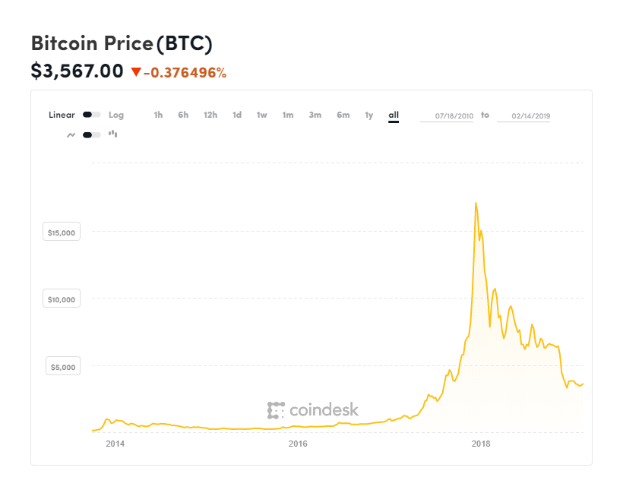
The end of it all?

Slide 10
Our discussion
Driven by the general Blockchain-DLT schema
  Previous lecture
Focus
  Engineering takeaways
  Key, reusable/reused solutions
On socioeconomic aspects: agnostic
Relatively light on technical details

Slide 11
Ledger Model

Slide 12
Foreword
We will simplify
  Some things will be weird, but important
  More than you probably want to know:
  https://bitcoin.org/en/developer-documentation
  Source of core figures
“The code is the specification”

Slide 13
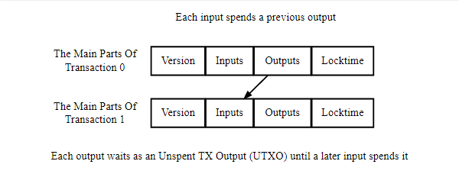
Ledger: Bitcoin transactions
Flow of “satoshis” through Txs
(Unspent) outputs created with Tx: UTXO
  Incl. rules on “spending” the output (e.g. recipient)

Slide 14
Ledger: Bitcoin transactions
Tx output:
entity on its own
SPENT
SPENT
UNSPENT
Ownership: ability to further spend,
not “having”

Slide 15
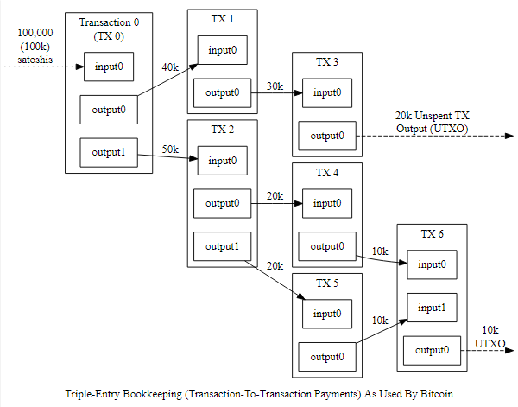
Transaction graph

Slide 16
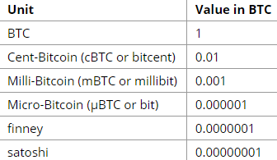
Denominations
Today: ~ 3500 USD (990k HUF)

Slide 17
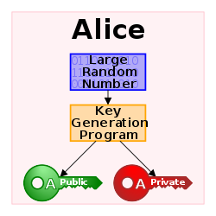
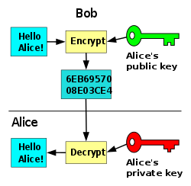
Public key/asymmetrical cryptography
Public key encryption
Digital signatures
https://en.wikipedia.org/wiki/Public-key_cryptography

Slide 18
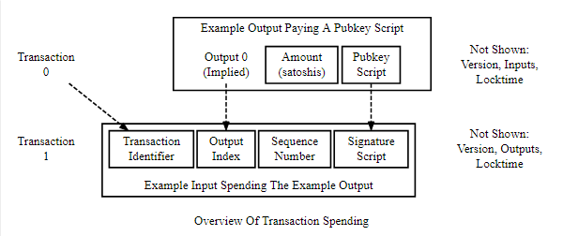
Input “spending” an earlier output
Alice puts “further spending condition” in Pubkey Script.
Simplest:
by signing this Tx + your further spending conditions
prove that you have the priv. key for the public key this Tx spends to
Bob: “data satistfying the conditionals of the Pubkey Script”

Slide 19
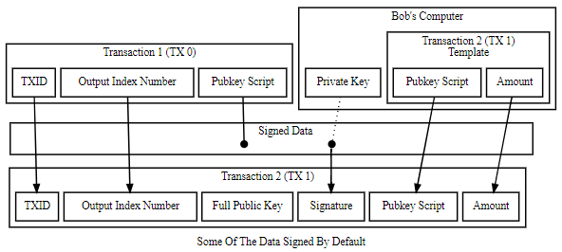
Some of the stuff signed

Slide 20
Rough workflow

Slide 21
It gets worse
(Some) standard transaction types
  Pay To Public Key Hash (P2PKH)
  Multisig (m sig: n pubkey)
  Null Data (unspendable pubkey script + arbitrary data)
Acceptance is actually script based
  Script “smart contracts”
  See P2SH scripts
  We really shouldn’t cover this here
And this gives us “anonymity”.
Receiver “identified” by public key

Slide 22


Slide 23
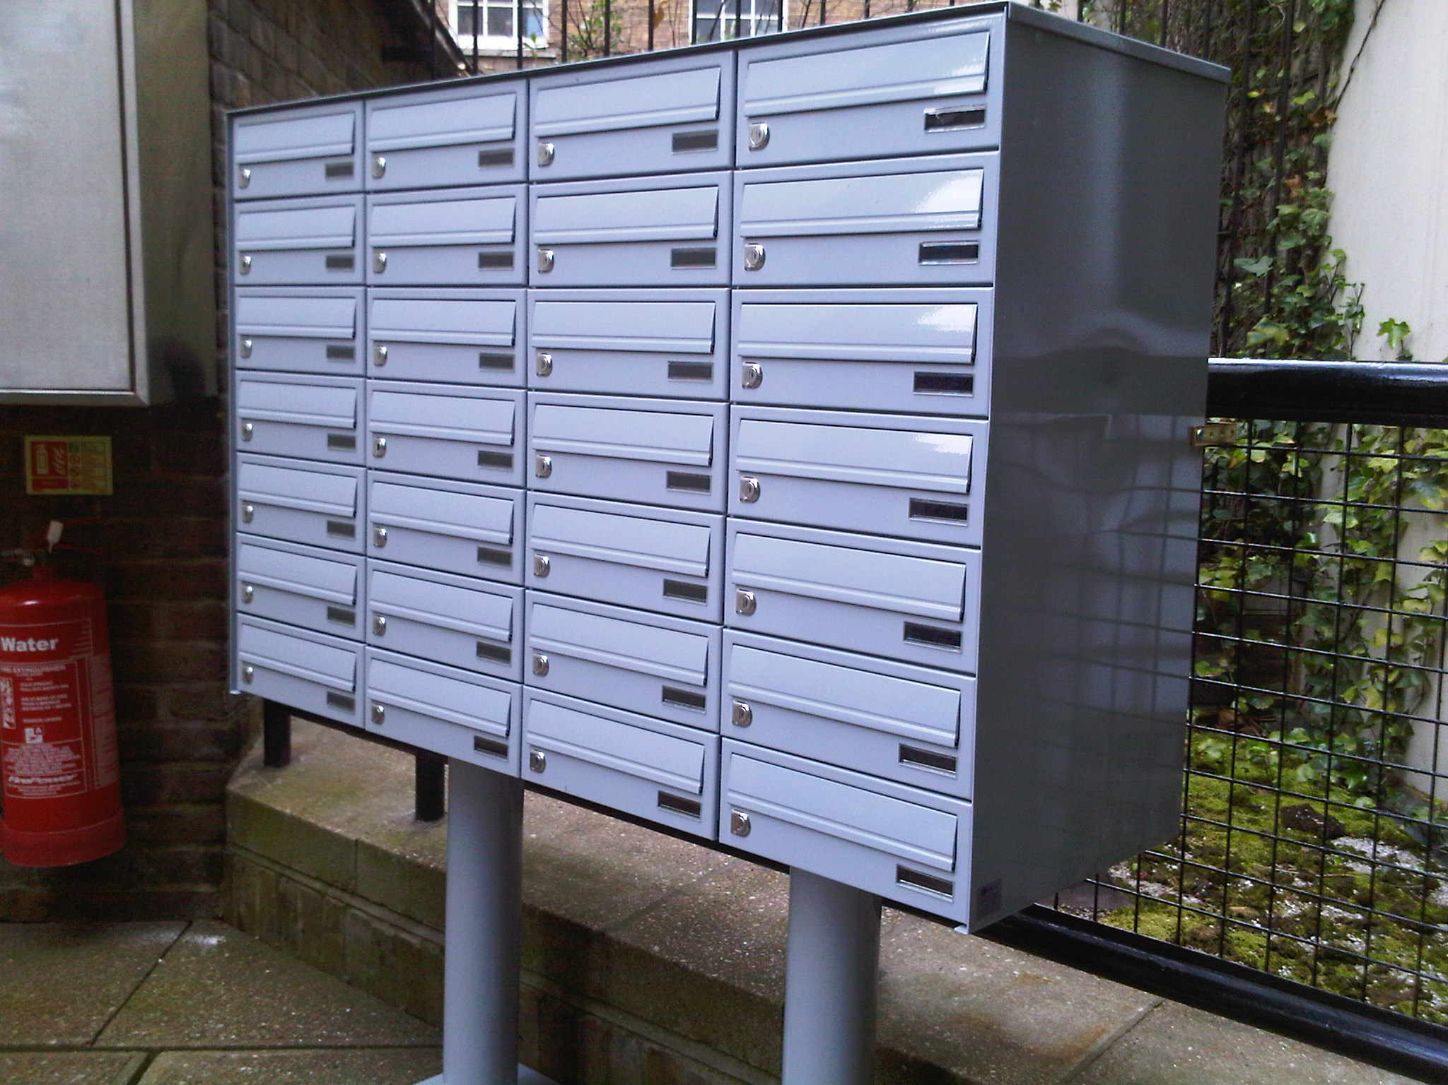

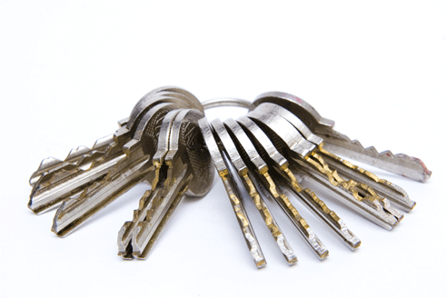
A workable Bitcoin ledger metaphor
Bitcoin addresses
Wallet
private keys
Ledger

Slide 24
A workable Bitcoin ledger metaphor
Wallet
signed Tx
private keys

Slide 25
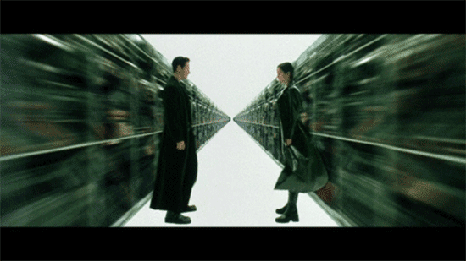
And what it misses

Slide 26
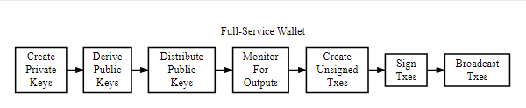
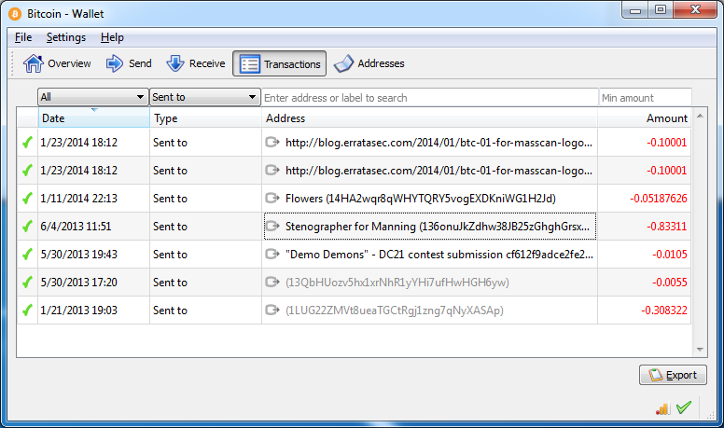
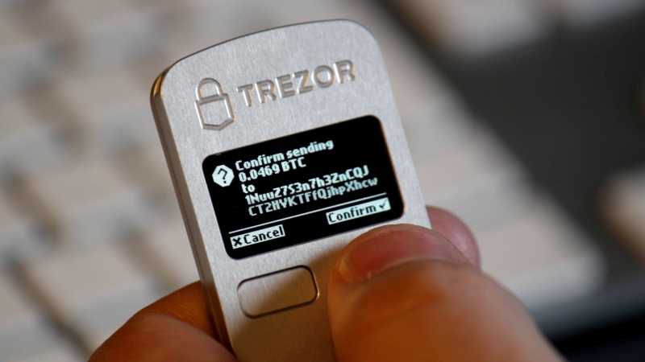
Wallet/wallet file
Wallet: program/service/device

Slide 27
Ledger model: user perspective
Users generate public “addresses”
Satoshi “packages” can be “placed” at addresses
If you have the private key: you can “spend” it
Transaction, and not account-based model
Actually only pseudonymous
Getting Bitcoin
  Receiving for goods & services (or as donation)
  Buying on an exchange
  Mining (later)

Slide 28
Some practices
You can pay a transaction fee
  Basis for prioritization
  SUM(inputs)-SUM(outputs)
Don’t reuse keys/addresses
  Spending habits easily trackable
  Some (limited) attacks
Don’t simply “send back money”
Spend “change” back to an address of yours

Slide 29
The P2P Consensus system

Slide 30
The problem
Maintain distributed consensus over the ledger
Malicious (Byzantine) peers possible
  Double spending, unauthorized spending, revocation…
The system is open
  BFT protocol family won’t fly

Slide 31
Underlying ideas
Peer incentive: “getting in on the action”
  Receiving units of the booked cryptocurrency
  Financially more profitable to play by the rules
  Helps the system grow large
  Today: no public Blockchain without cryptocurrency
Reward tied to committing real resources
  Simple “election rigging” shouldn’t work
Reward probabilistic, commitment-proportional
  No “winner takes it all”

Slide 32
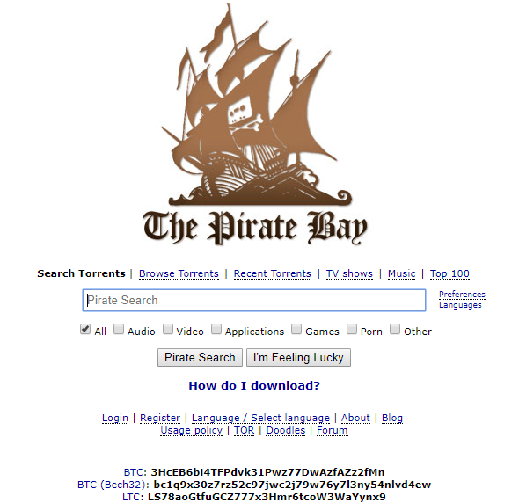
Remember this?
What’s the peer incentive?
Did/does it work?
  Think leechers
Could we blockchainify?

Slide 33
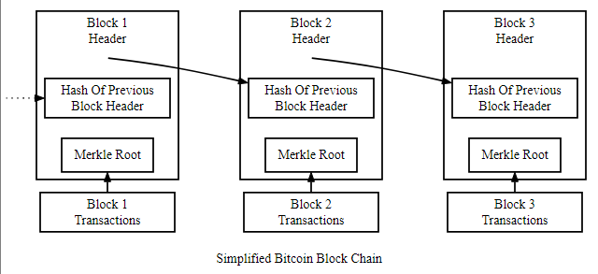
Blockchain with Proof of Work
Hash of the Txs
(Root of a tree of hashes)

Slide 34
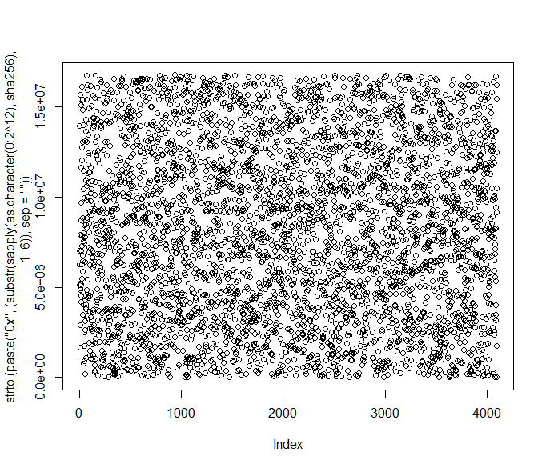
Hashing the header
0..2^12: x → sha256(x) / 2^232
Just for demo!

Slide 35
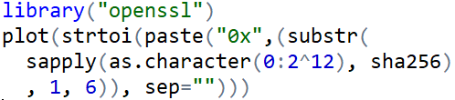
Hashing the header
(Good) cryptographic hash functions
  “One-way function” (preimage resistance)
  Collision resistance
  Uniform and well randomizing
  …
  Standard
In this context: cryptographic primitive
Playing around with them is easy

Slide 36
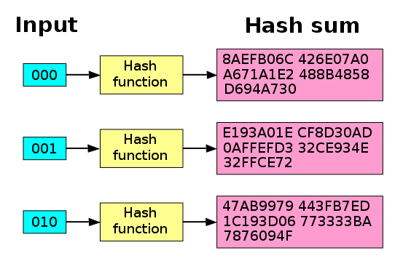
A bit more formally: avalanche effect
Single input bit flip: p=0.5 flip in all output bits
  “Strict avalanche criterion”
  Hash is still deterministic!
  Input sweep --> output “trashes around randomly”
Figure: https://en.wikipedia.org/wiki/Avalanche_effect

Slide 37
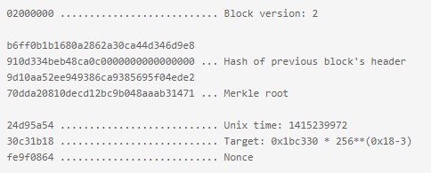
The cryptographic puzzle
Find a nonce
that makes the header hash
smaller than the target!

Slide 38
Proof of Work
== “crack SHA256”!
What works: distributed brute force
  Trying out possible nonces
  Sooner or later a peer stumbles on a good one
“Proof of Work”?
  If a nonce is found: probabilistically proves that the network did enough (futile) hashing tries
Winner peer of the lottery/race: gets some new Bitcoin!
  Technically: “coinbase” Tx
  Until 21 million BTC released
  Also: Tx fees
  Your chances determined by your hashrate
Target: 2016 blocks / 2 weeks
  Network adjusts difficulty (every 2016 block)
  10 minutes / block

Slide 39
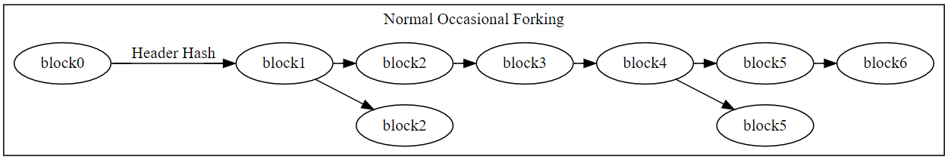
Tx block inclusion is not final validation
Global P2P system
  Tx propagation takes time
  Block content can differ
  “Parallel” block mining + broadcast possible
  (P2P protocols are messy, always been)
Short forks are normal
  Honest miners extend “most work” branch
  Automatically reconverges
  “Lost work” in stale blocks: invalidated Txs picked up downstream

Slide 40
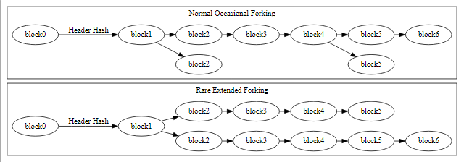
Defense against double spending (and other)
Not normal; large scale attack?
To “spend again” Bitcoin in block3
modify
mine a longer chain than block3..block6
+ what’s mined in the meantime
Stupidly large amount of work to redo!
Recall: block-to-block hashing

Slide 41
Tx confirmations and protection
Confirmations | Double spend protection
0 | Mempool, not in mined block yet. Risky to trust.
1 | Dramatically lower risk, but most recent block replaced fairly often
2 | In block + one more block; replacement rare
6 | Tx buried in 1 hour work of the global P2P system. Considered safe.
Recall: first time-to-confirm depends on fee
Basically, risk analysis
There are some ways to monitor double-spend attempts

Slide 42
51% and lesser attacks
Majority attack
  Control of >50% of the hashrate
  Statistically faster to forge long “replacement chains”
  Receiver confirmation count wait: no defense
  Cost increases with depth
Nonmajority attack?

Slide 43
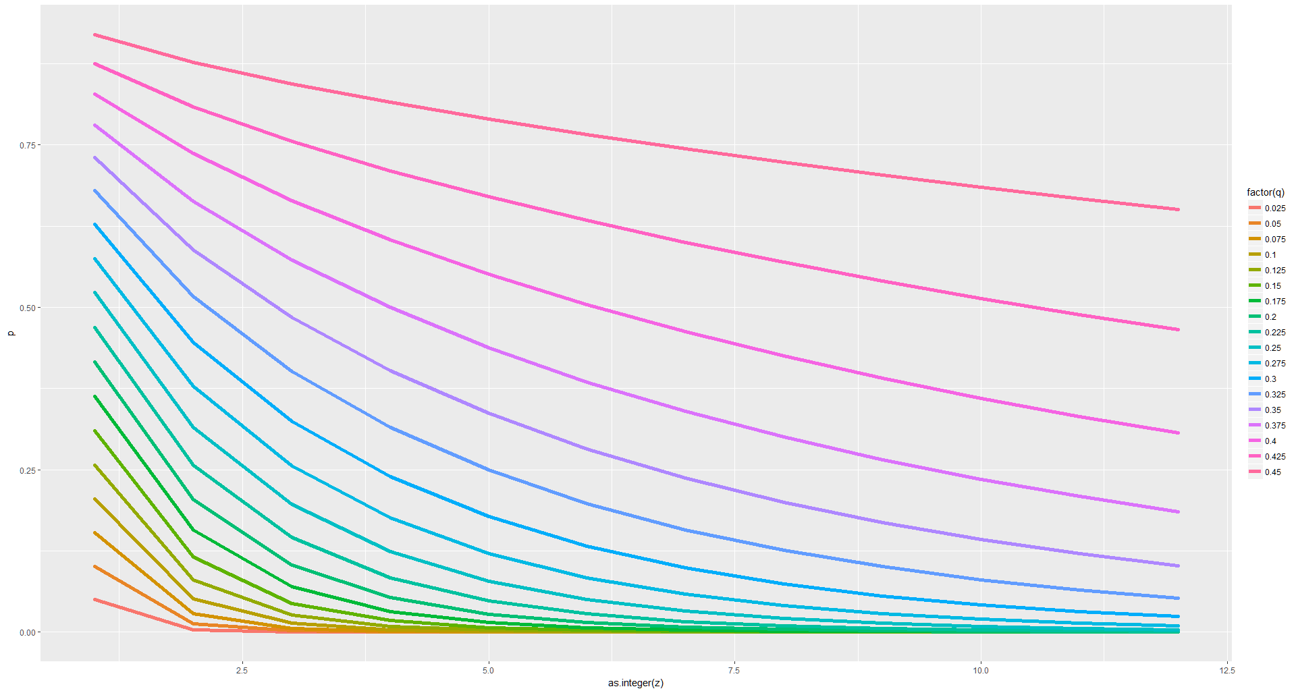
Attacker catch up probability
Game theory/statistics, not CS-on-protocols
Gambler with unlimited credit, starting debt, unit bets:
p of breakeven?
Hashrate portion: 0.45 … 0.025
P
Block depth
Note: not a production quality figure.
Notes:
mylambda <- function(q,z,k){
l <- z*q/(1-q)
l^k * exp(-l) / factorial(k) * (1 - (q/(1-q))^(z-k))
}
attackprob <- function(q,z){
1 - sum(sapply(0:z, function(x){mylambda(q,z,x)}))
}
attackdf <- function(qin){
data.frame(q=qin, z=1:12, p=sapply(1:12, function(x){attackprob(qin,x)}))
}
d <- Reduce(rbind, lapply(seq(from=0.025, to=0.45, by=0.025), attackdf))
library(ggplot2)
qplot(data = d, x = as.integer(z), y = p, colour = factor(q)) + geom_line(size = 2)

Slide 44
(Not-so-)basics we didn’t cover
Blockchain
  Merkle trees, full and SPV nodes, pruning, locktime, seq numbers
  Consensus rule changes: soft & hard forks
  Crypto specifics
  P2P mechanics, testnet and mainnet
“Contracts”
  Escrow, arbitration
  Micropayment channels
  CoinJoin
Usage
  Wallet strategies, HD wallets, hot and cold wallets
  Payment processing
  Client-peer RPCs, app dev
  “What should I run” (full, SPV, node-less, …)
SegWit and similar

Slide 45
The BTC Ledger

Slide 46
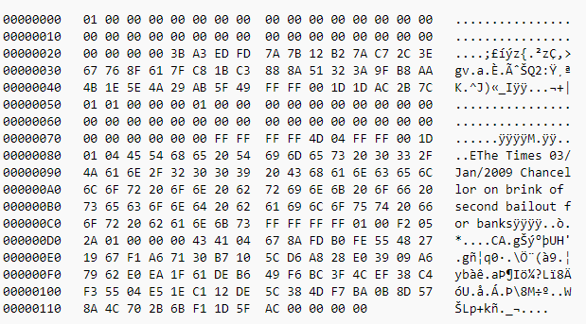
The genesis block

Slide 47
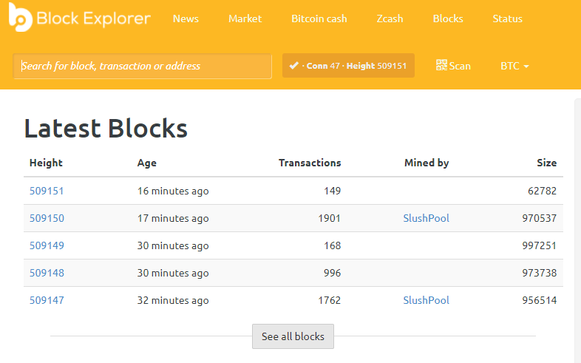
Network working & stable

Slide 48
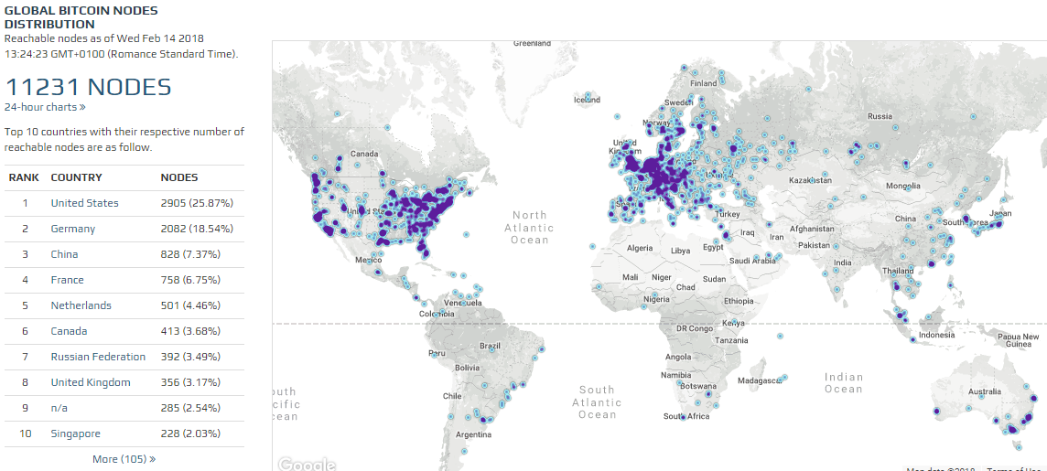
Global P2P system

Slide 49
Current Bitcoin statistics from BitInfoCharts

Slide 50
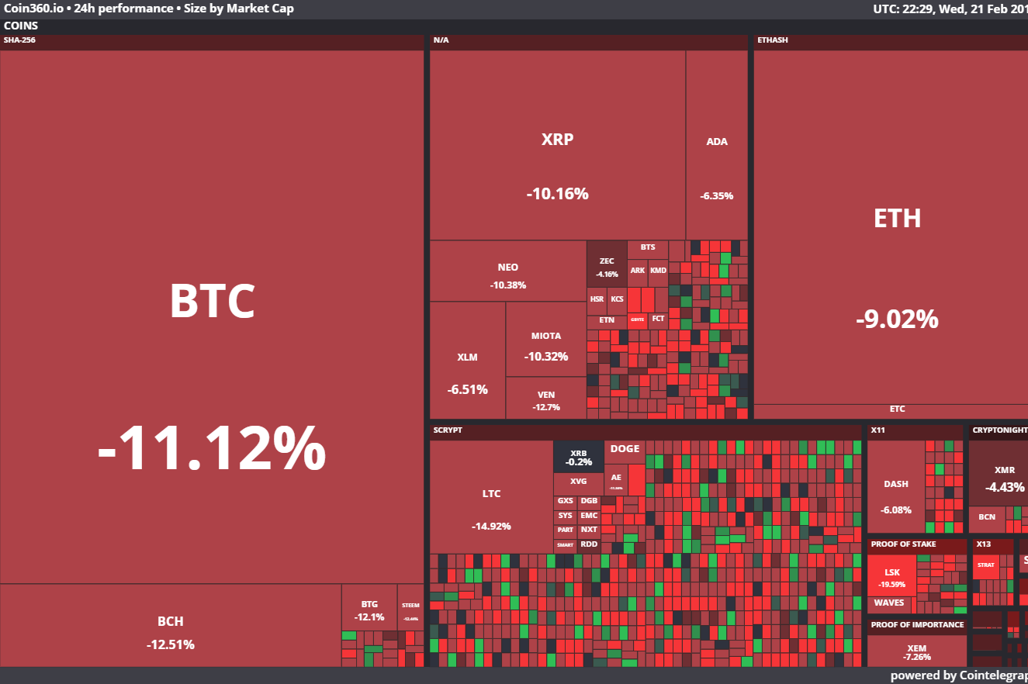
Coins by market cap
Type of consensus
177 billion USD

Slide 51
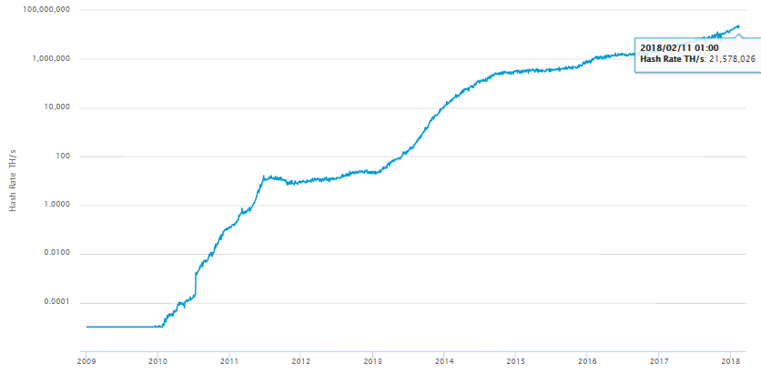
Network hashrate

Slide 52
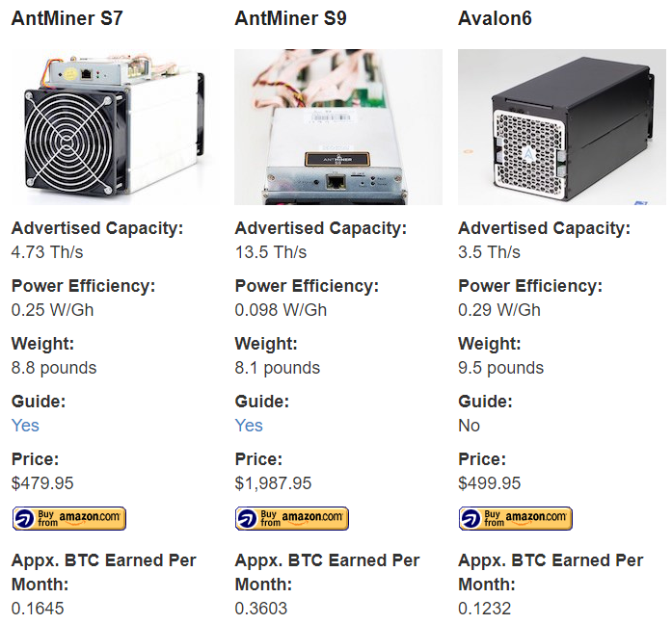
Mining
ASIC
Not even GPU
Core i7: few Mh/s
Figure: https://www.bitcoinmining.com/bitcoin-mining-hardware/
Figure: https://www.coindesk.com/samsung-confirms-its-now-making-cryptocurrency-mining-chips/

Slide 53
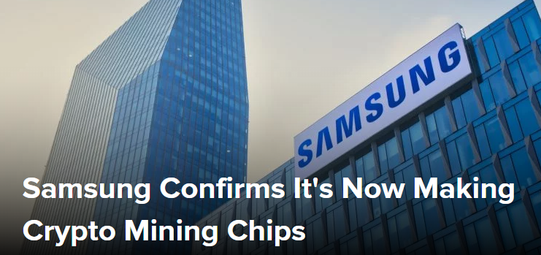
Mining
ASIC
Not even GPU
Core i7: few Mh/s
Figure: https://www.bitcoinmining.com/bitcoin-mining-hardware/
Figure: https://www.coindesk.com/samsung-confirms-its-now-making-cryptocurrency-mining-chips/

Slide 54
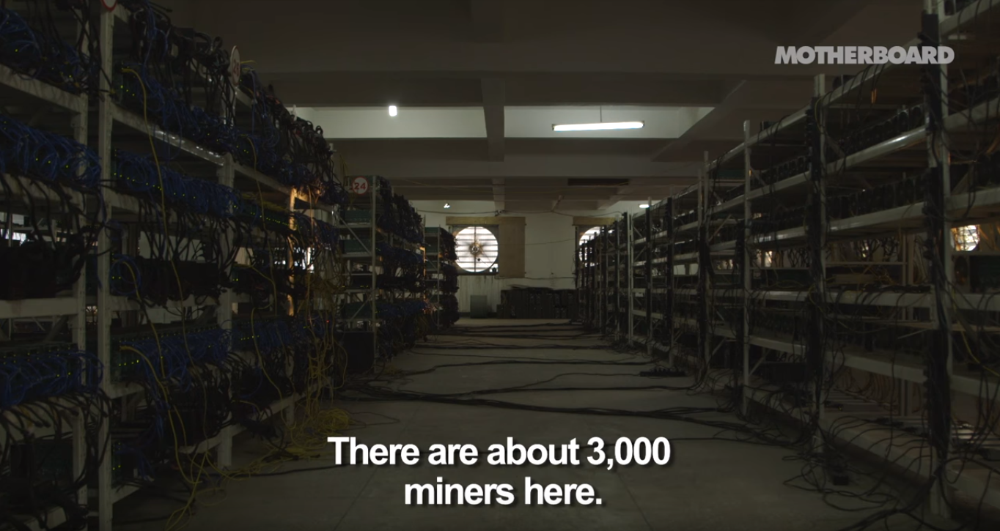
Bitcoin mines
Cheap electricity is paramount
Picture: https://www.youtube.com/watch?v=K8kua5B5K3I

Slide 55
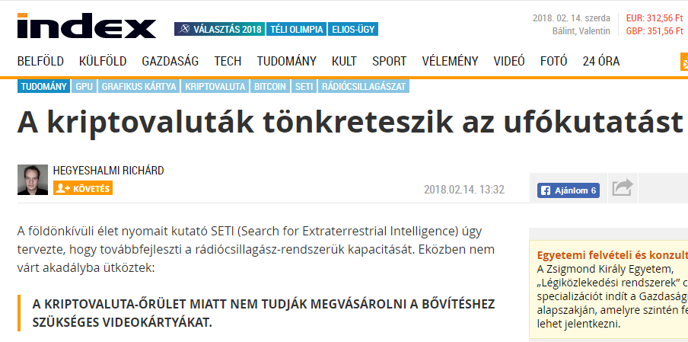
Mining: unintended consequences

Slide 56
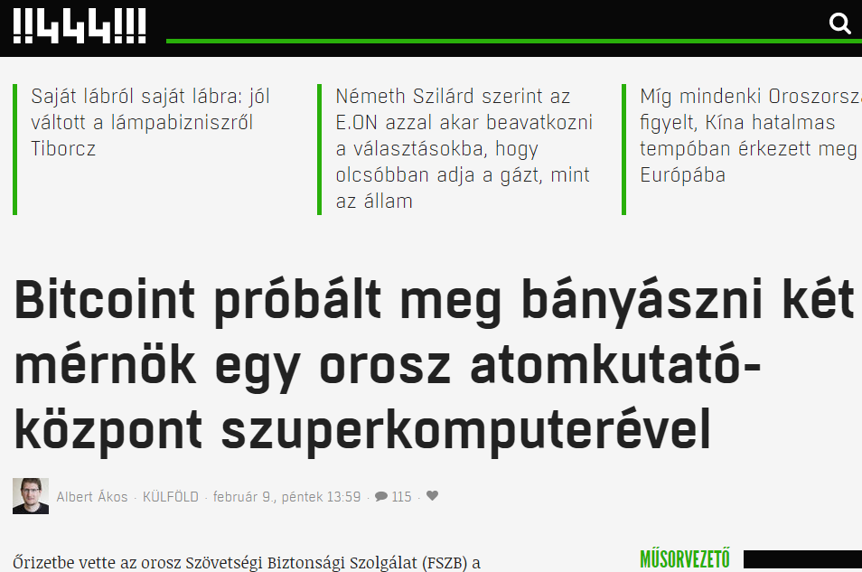
Mining: you are doing it wrong

Slide 57
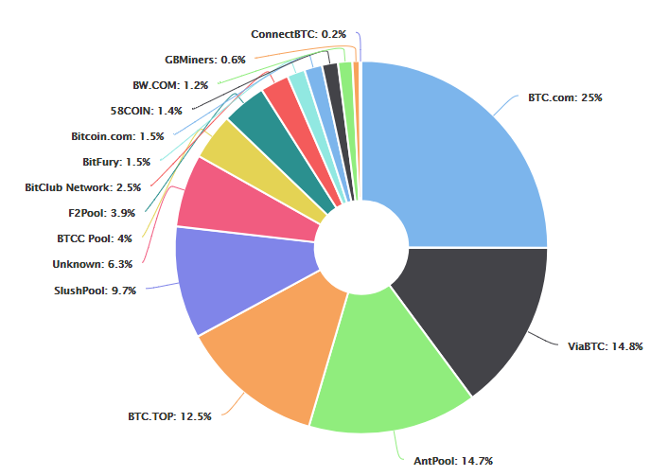
Mining pools
Contribute resources to a pool
Cloud mining: mostly a scam
Mining pools + China: how was that with decentralization?
Many miners switch between coins based on profitability

Slide 58
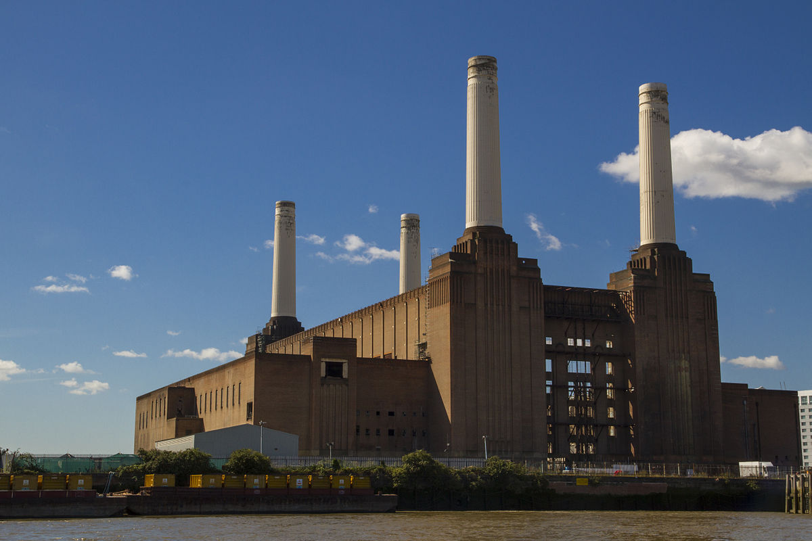

Was this really the intention?
PoW Proof-of-Semi-Centralized-Coal-Mine-Burning-in-China
Essentially industrialized mining
  Not democratic at all
  Unbelievably wasteful
  Although some “currency backing”
Many unintended consequences here…
Options?
  Other PoWs are less “ASIC-able”; at least GPU
  Proof-of-Space, Proof-of-Storage, …
  Proof-of-Stake
  Proof-of-Useful-Work?
We plan to cover some of this later

Slide 59
Can this be a “payment” network?
“Is it money?” is a different question
“When does the music stop?” is another one

Slide 60
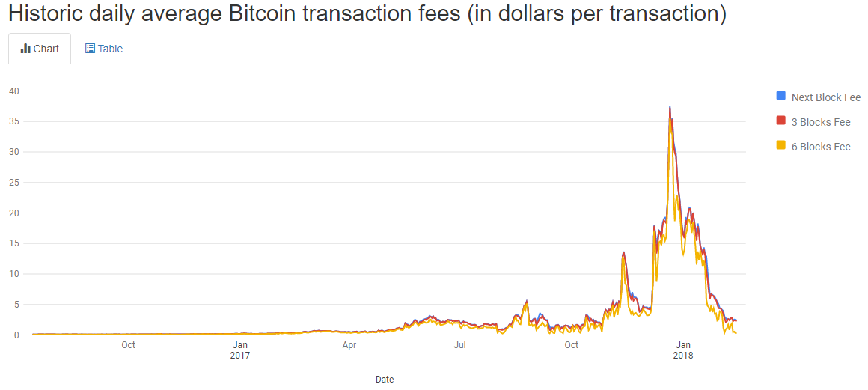
Transaction fees
Source: https://bitcoinfees.info/

Slide 61
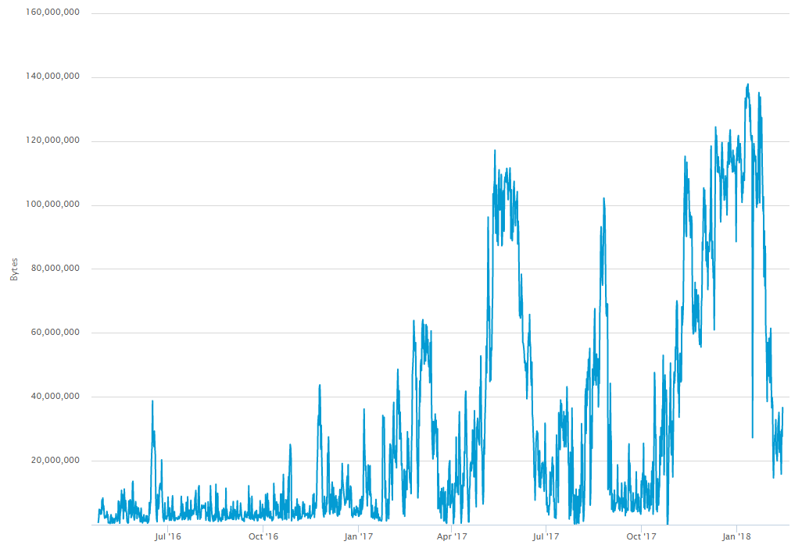
Mempool size (unconfirmed Tx)
Avg Tx: ~500 bytes
Source: https://blockchain.info/hu/charts/mempool-size?timespan=all

Slide 62
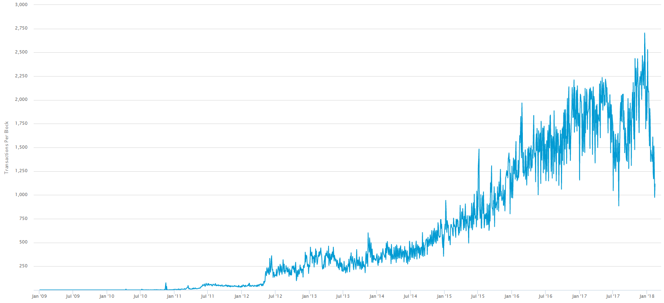
Average Tx per block
https://blockchain.info/charts/n-transactions-per-block?timespan=all

Slide 63
“Cryptocurrency and payment network”
Right now, ill-suited to payment network role
  In itself; more on that later
“Currency”? More a “cryptocommodity”
  Although that has another meaning by now
There were (and will be?) forks
  BTC/BCC
More on “moneyness” and markets: March 22

Slide 64
Closing Remarks

Slide 65
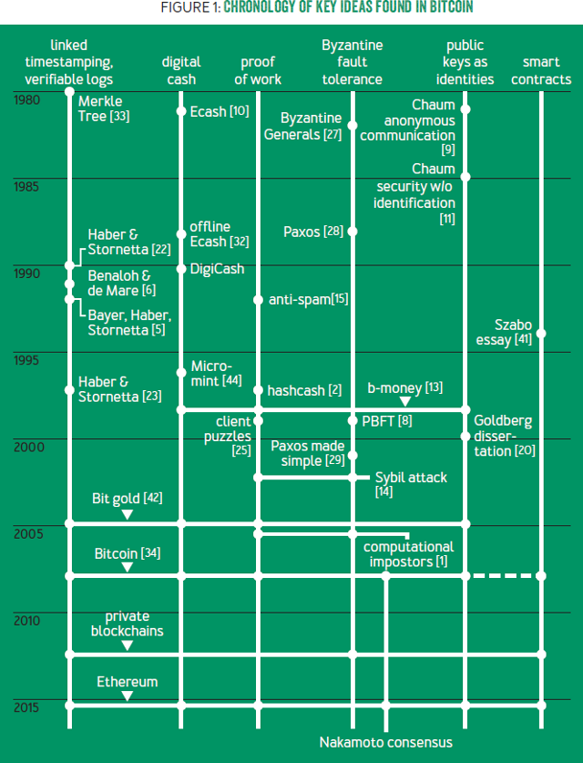

Novelty and academic pedigree?
Source: https://queue.acm.org/detail.cfm?id=3136559

Slide 66
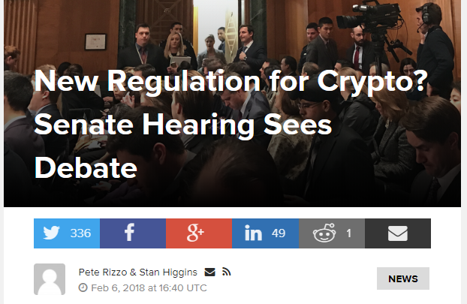
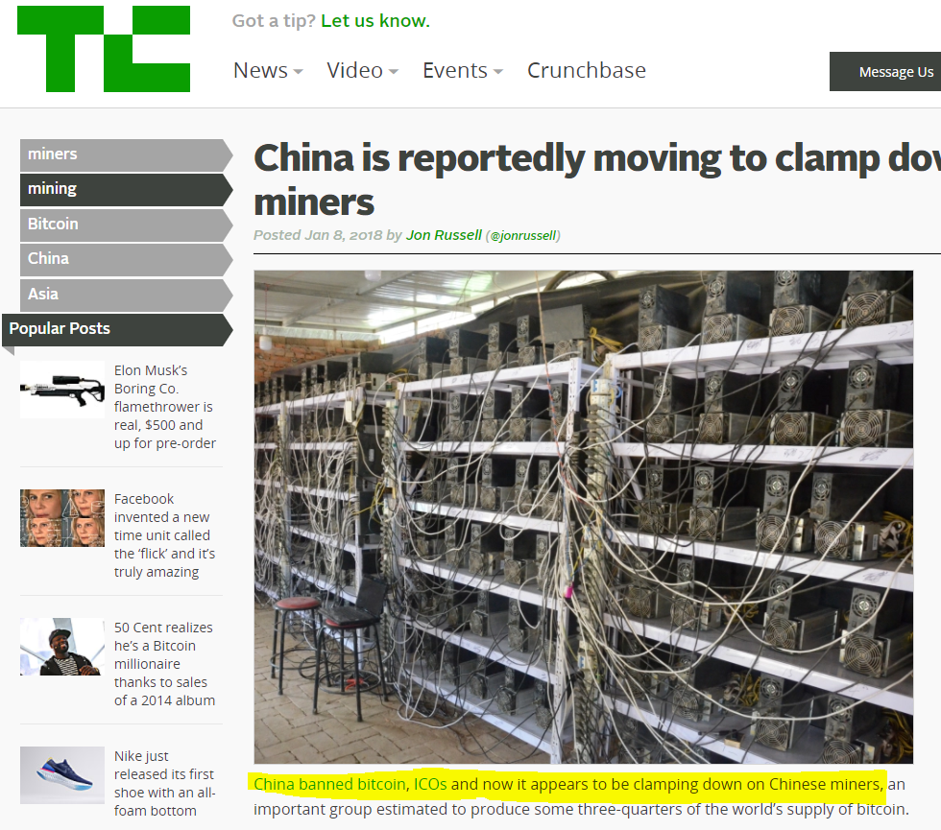
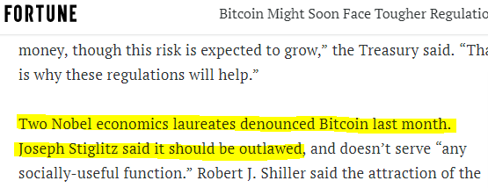
Legal standing?
Regulation will come, and…
DLT enjoys universal support.
More and more noise on CBDC

Slide 67
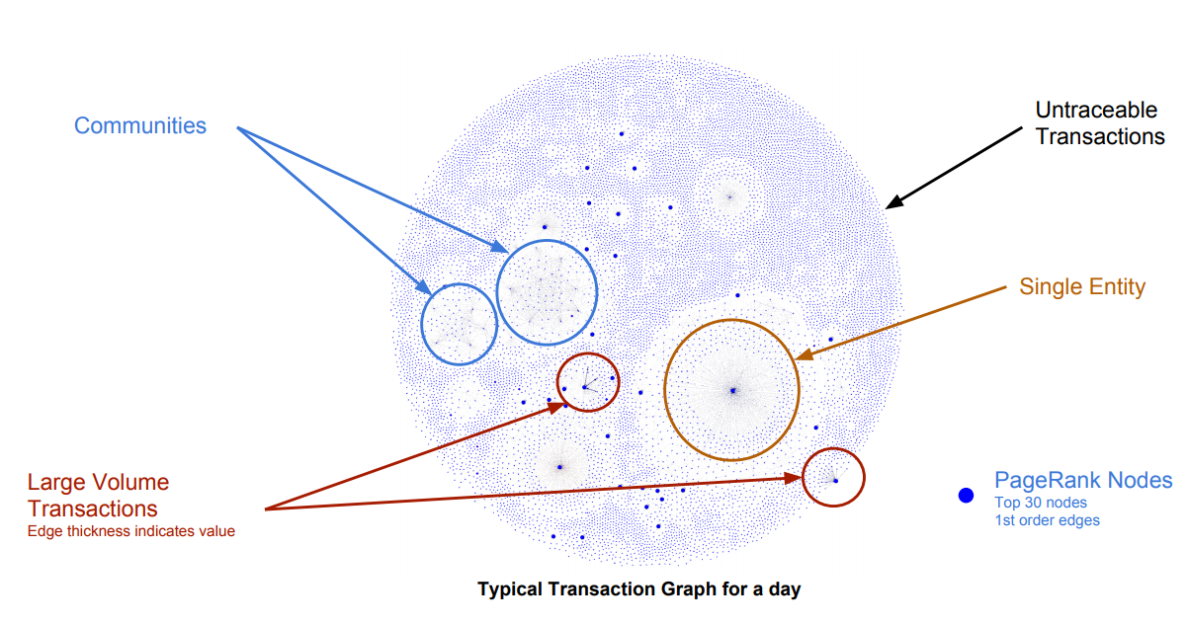
Pseudonymity, not anonymity
Source: http://people.csail.mit.edu/spillai/data/papers/bitcoin-transaction-graph-analysis.pdf

Slide 68
Topics avoided
Questions we consciously avoided
  Should I invest in Bitcoin?
  How do I trade Bitcoin?
  Should I invest in mining?
  How is this taxed?
  Can I legally accept Bitcoin in my shop?
But: should I understand how Bitcoin works?
  Absolutely.

Slide 69
