Slide 1
Hyperledger Fabric: notes on dependability, integration
Blockchain Technologies and Applications
Imre Kocsis, ikocsis@mit.bme.hu
2019. summer semester

Slide 2
A Few Notes On DePendability

Slide 3
Common thinking and the reality
PoW consensus: “51% attack”
Although we saw the actual game theoretical model
PBFT consensus: ~1/3 malicious nodes tolerated
To tolerate f Byzantine nodes, 3f+1 nodes required
Fabric 1.0+ has/will have PBFT orderer
Reality is not so simple
We saw overload faults (w.r.t. “engineered capacity”)
Fabric 1.0+ heterogenous: fault/attack types matter

Slide 4
System failures (indicative, for byzantine node faults)
+ Clients
Depending on endorsement policy and level of corruption: no effect, unavailability or consistent arbitrary modifications

Slide 5
System failures (indicative, for byzantine node faults)
Consistent reorders and Tx drops: limited malicious modifications or unavailability
Inconsistent –” –: inconsistent ledger state (self- correction?)

Slide 6
System failures (indicative, for byzantine node faults)
Local effects

Slide 7
Dependability mechanisms?
Very immature topic
“Design for dependability” can be done
And should
As an integral part of designing:
Network
Endorsement policy
Deployment
FTA, FMEA, modern Error Propagation Analysis approaches, …
At least client failures can be addressed
Monitor, de-enroll client, compensatory transactions
“Manual rollback”: not nice, but not DAO-like, either

Slide 8
Blockchain-based solution Design?

Slide 9
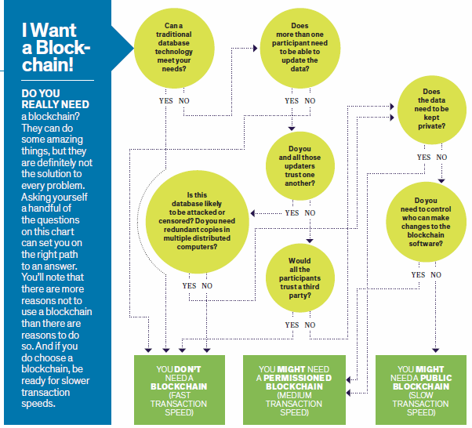
When to Blockchain?
But do add the “bling” factor
Not needing != doesn’t make sense
Compare & contrast: “value driver” model
functional model
types of consortia
Source: M. E. Peck, “Blockchain world - Do you need a blockchain? This chart will tell you if the technology can solve your problem,” IEEE Spectrum, vol. 54, no. 10, pp. 38–60, Oct. 2017.

Slide 10
General remarks
Again: very immature area
Many key questions: business analyst and above
System engineering & architecture design
Tokenization/data modelling
Integrating existing systems
Mapping processes to ledger-based execution
Consortial/private: deployment design
Integrating ledgers
Standards?
Also what we skipped during the Composer lecture:

Slide 11
Developing for Hyperledger Fabric
Hyperledger Fabric
Initial requirements
Hyperledger constraints
Artifacts
Cooperation requirements
Business logic
Data modeling restrictions
Database capabilities
Deployment capabilities
Deployment requirements
Go/Java logic
Usable chaincode API
Crypto material
Deployment config
Go/Java chaincode
Deployment solution
Running blockchain
User interface requirements
Reconfiguration requirements
Admin API
Client API
Client frontend

Slide 12
Developing for Hyperledger Composer
Hyperledger Composer
Cooperation requirements
Business logic
Deployment requirements
Deployment capabilities
High level of abstraction
Assets, participants
Queries
Deployment config
Crypto material
Transactions
Access control
Deployment solution
?
Running blockchain
Reconfiguration requirements
Client frontend
User interface requirements

Slide 13
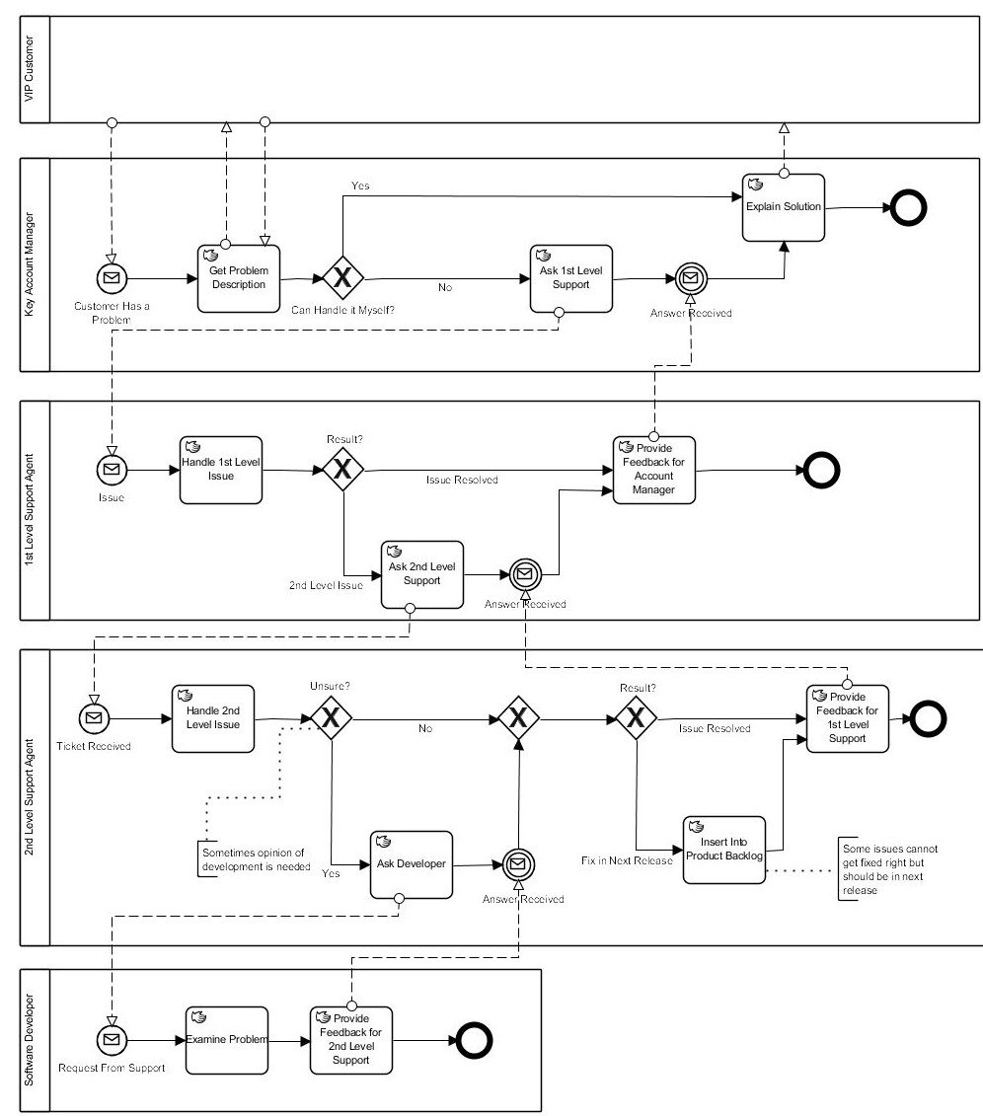
Processes and ledger networks
Cooperations as channels?

Slide 14
Ledger integration

Slide 15
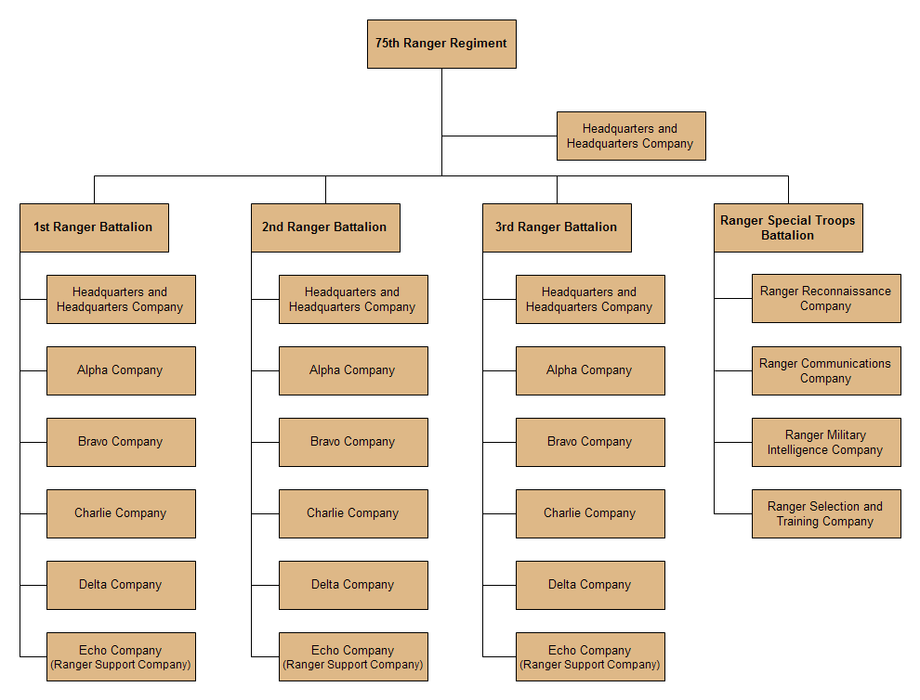
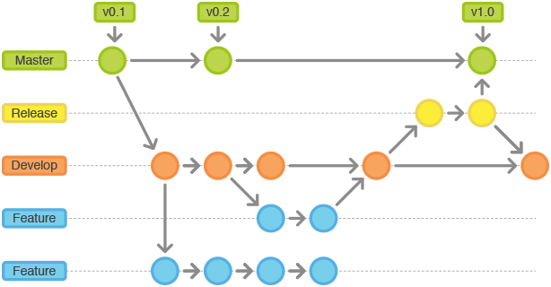
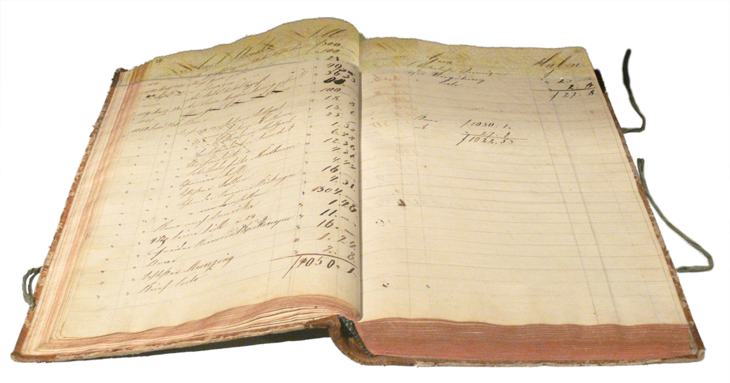
Blockchain as an integration layer
Processes & workflows
Business processes
Transactions
Business actions
Architecture
Data model

Slide 16
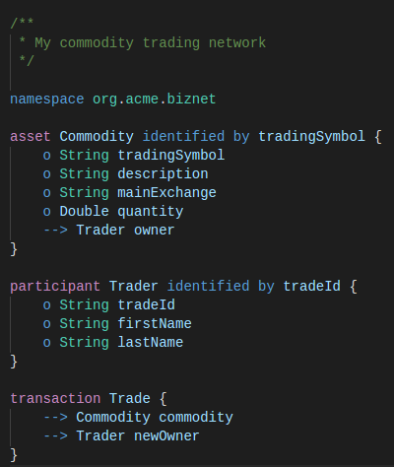
Common ledger - common data models
Challenge: semantic interoperability
Requires common data models
Emerging standard-based domain models
Domain modeling with a ledger target
ERCx, …, TradeLens, Hyperledger Grid, Monax SDKs (legal, financial, supply chain), …
DAML, Hyperledger Concerto, Ivy for Bitcoin, …

Slide 17
Architecture – the basic challenge
Enterprise data
Organizational users
Distributed Ledger
Enterprise applications
Blockchain applications
Enterprise identity management

Slide 18
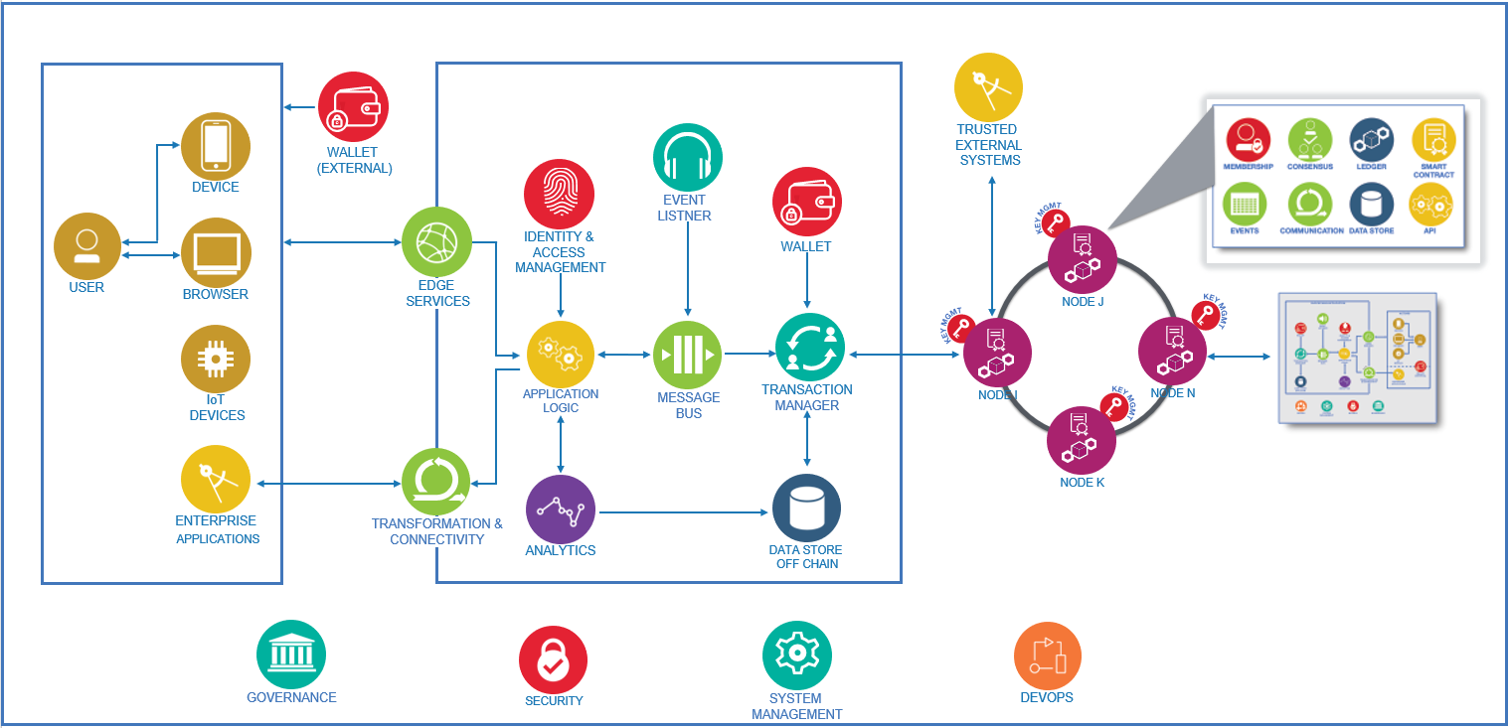
Typical functional blocks

Slide 19
The “Cloud Advantage”

Slide 20
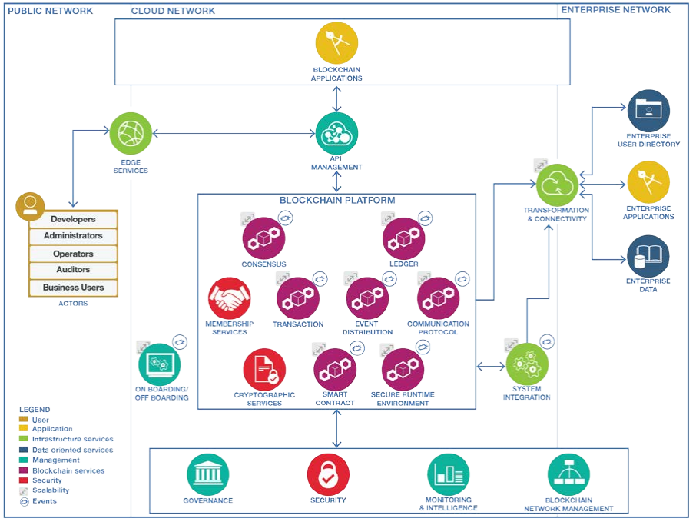
Blockchain reference architecture
https://www.omg.org/cloud/deliverables/CSCC-Cloud-Customer-Architecture-for-Blockchain.pdf

Slide 21
Blockchain as a Service
IoT
Blockchain applications
Identity management integration
Event processing
Managed APIs
Gateway APIs
Database view
Blockchain-as-a-Service
Cloud “service bus” and service composition

Slide 22
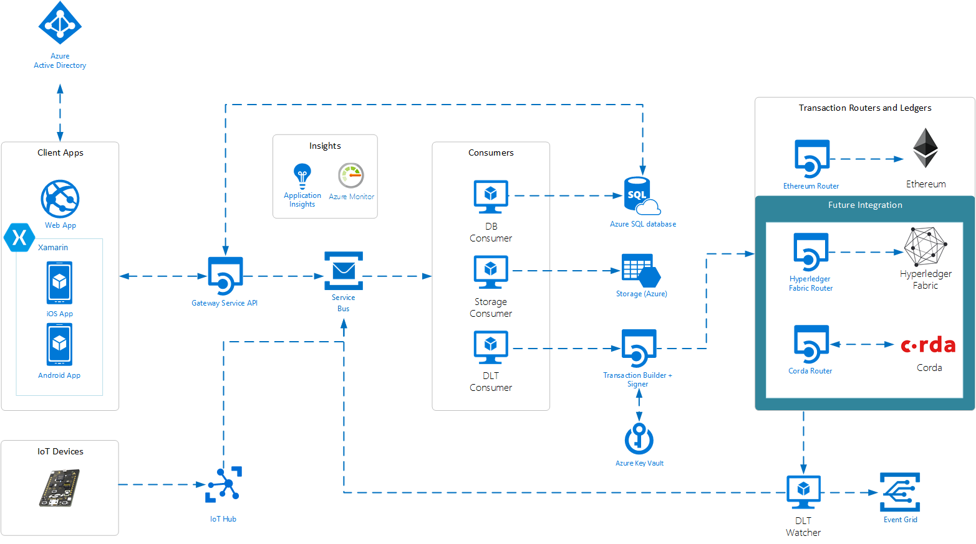
Azure Blockchain Workbench
https://docs.microsoft.com/en-us/azure/blockchain/workbench/architecture

Slide 23
Oracles

Slide 24
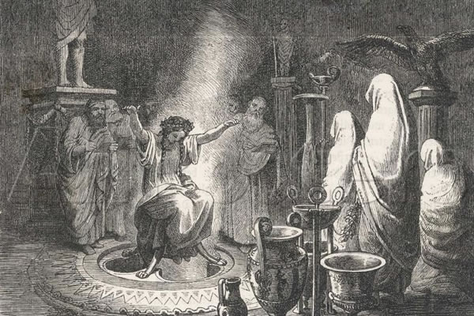
Oracles
Problem: agreement only on computation + data on the BC
Oracles: “connect two worlds”
Trusted entities that attest to facts on external data
Not that much of a problem, if correctness proof is…
Cryptographical (e.g., from other BC)
Computational (off-chain checking?)

Slide 25
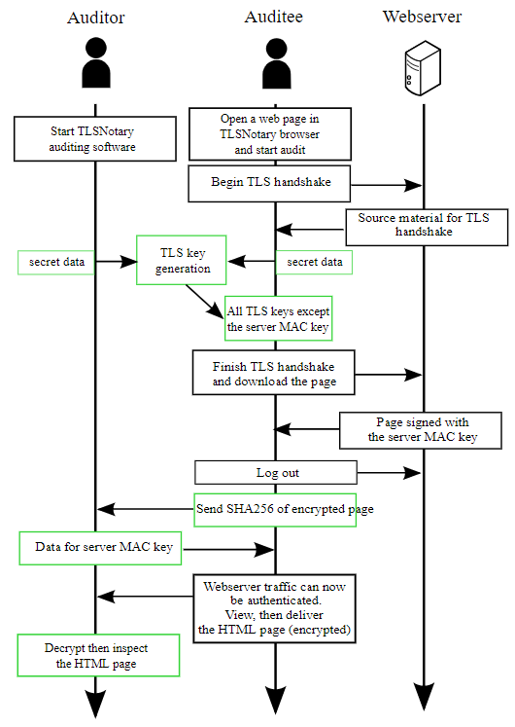
TLSNotary
Utilizes a TLS capability for “Splitting” the master key
Makes Oracle services feasible
+
Distributed Oracles coming(?)
https://tlsnotary.org/TLSNotary.pdf
Also see: https://docs.oraclize.it/#security-deep-dive

Slide 26
Transactional InteGration

Slide 27
Transactional integration patterns
Consensus: we are moving towards a “world of many ledgers”
How do we construct the “Internet of Value”?
Main integration patterns
2-way atomic asset swap between ledgers
Instead of exchanges
See https://en.bitcoin.it/wiki/Atomic_cross-chain_trading
Sidechaining
Rather complex for 2-way peg and probabilistic finality
Direction: federation with “relay chains” (see Polkadot)
Cross-ledger transactions – specifically: payment
Motivation: Lightning Network

Slide 28
The Interledger Protocol (ILP)
Motivated by the Lightning Network
Same “algorithmically routed chain of intermediaries”
But more general
Lightning network concept needs certain features
importantly, time-locked Txs
Upside: “payment” through chain of practically any ledgers
pontentially even “classic” ones
Downside: potentially higher risk for parties
Chain of conditional transfers: essentially 2PC
W3C standard
Brought by Ripple into Hyperledger

Slide 29
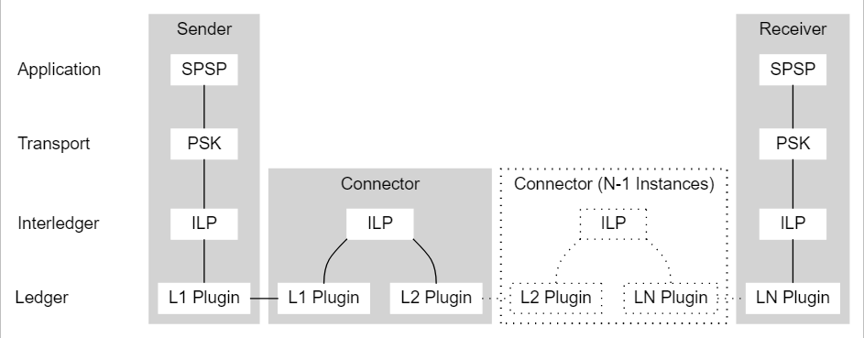
The basic ILP concept
“Example”: Simple Payment Setup Protocol
Now: “Pre-Shared Key” or “Interledger Payment Request”

