Slide 1
Not So Smart Contracts Vulnerabilities and Verification
Blockchain Technologies and Applications
Ákos Hajdu, hajdua@mit.bme.hu
Imre Kocsis, ikocsis@mit.bme.hu

Slide 2
Motivating example
Simplified version of the DAO hack
Attack scenario example
contract Bank {
mapping(address=>uint) balances;
function deposit() payable {
balances[msg.sender] += msg.value;
}
function withdraw(uint amount) {
if (balances[msg.sender] >= amount) {
if (!msg.sender.call.value(amount)("")) {
revert();
}
balances[msg.sender] -= amount;
}
}
}
Data: balance of each user
Operation: deposit money
Balances
C U1 U2
U2
Receive money
Withdraw 50
100 50+50
Increase balance
Check ok
Operation: withdraw money
50 50+50
Transfer 50
Check balance
Transfer money
Withdraw 50
Reduce balance
Check ok
0 50+50
Transfer 50
0 50+0
Reduce 50
0 50+(-50)
Reduce 50
Vikram Dhillon, David Metcalf, and Max Hooper. The DAO hacked.
In: Blockchain Enabled Applications, pp. 67–78. Springer, 2017.

Slide 3
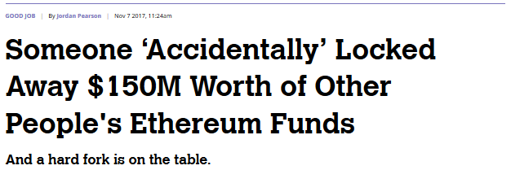
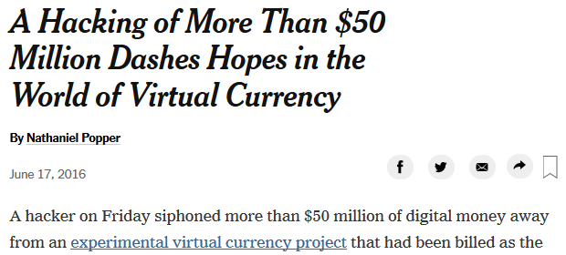
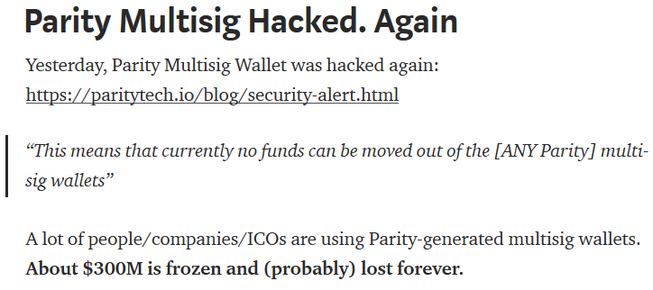
More motivating examples
National Vulnerability Database (NVD)
400+ vulnerability records for blockchain
95%+ are programming errors in contracts
https://nvd.nist.gov/vuln/

Slide 4
Where do the problems come from?
New paradigm for developers
Cf. sequential vs. parallel programming
Accounts, blockchain, transactions, mining, …
Semantic misalignments
Easy to make errors
Problems at different levels
Programming language / contracts
Execution engine
Blockchain and cross-peer protocols
Atzei, Bartoletti, Cimoli - A survey of attacks on Ethereum smart contracts (2017)
Luu, Chu, Olickel, Saxena, Hobor - Making Smart Contracts Smarter (2016)
Nikolic, Kolluri, Sergey, Saxena, Hobor - Finding The Greedy, Prodigal, and Suicidal Contracts at Scale (2018)
https://consensys.github.io/smart-contract-best-practices/known_attacks/
https://solidity.readthedocs.io/en/latest/security-considerations.html

Slide 5
What can possibly go wrong?
Programming language / contracts
Call to the unknown
Gasless send
Mishandled exceptions
Type casts
Reentrancy
Keeping secrets
Unchecked caller
Input validation
function withdraw(uint amount) {
require(balances[msg.sender] >= amount);
msg.sender.transfer(amount);
balances[msg.sender] -= amount;
}
function withdraw(uint amount) {
require(balances[msg.sender] >= amount);
msg.sender.send(amount);
balances[msg.sender] -= amount;
}
function withdraw(uint amount) {
require(balances[msg.sender] >= amount);
if (!msg.sender.send(amount)) revert();
balances[msg.sender] -= amount;
}

Slide 6
What can possibly go wrong?
Execution engine
Under/overflows
Immutable bugs
Ether lost in transfer
Stack size limit
uint8 x = 255;
uint8 y = 1;
uint8 z = x + y; // z == 0
int8 x = 127;
int8 y = 1;
int8 z = x + y; // z == -128

Slide 7
The BECToken
contract BecTokenSimplified {
using SafeMath for uint256;
uint256 public totalSupply;
mapping(address => uint256) balances;
constructor() {
totalSupply = 7000000000 * (10**18);
balances[msg.sender] = totalSupply;
}
function batchTransfer(address[] receivers, uint256 value) returns (bool) {
uint256 amount = receivers.length * value;
require(value > 0 && balances[msg.sender] >= amount);
balances[msg.sender] = balances[msg.sender].sub(amount);
for (uint i = 0; i < receivers.length; i++) {
balances[receivers[i]] = balances[receivers[i]].add(value);
}
return true;
}
}
Total tokens
Balance of each user
Initialization
Creator gets 7x10²⁷
Batch transfer value to N receivers
Total amount = value x N
Reduce sender balance by total
Increase receiver balances by value N times

Slide 8
The BECToken
Creator | Attacker1 | Attacker2 | Attacker3 | Attacker4 | Attacker5
7x10²⁷ | 0 | 0 | 0 | 0 | 0
Σ 7x10²⁷
Let’s „print” money
value = 28948022309329048855892746252171976963317496166410141009864396001978282409984;
attacker1: bectoken.batchTransfer([attacker2, attacker3, attacker4, attacker5], value)
N = 4
amount = value * N = 0
Creator | Attacker1 | Attacker2 | Attacker3 | Attacker4 | Attacker5
7x10²⁷ | 0 | 2.9x10⁷⁶ | 2.9x10⁷⁶ | 2.9x10⁷⁶ | 2.9x10⁷⁶
Σ 1.16x10⁷⁷
Really happened (with different parameters)
https://medium.com/@peckshield/alert-new-batchoverflow-bug-in-multiple-erc20-smart-contracts-cve-2018-10299-511067db6536

Slide 9
What can possibly go wrong?
Blockchain and cross-peer protocols
Unpredictable state
Transaction ordering dependency
Generating randomness
Time constraints
Timestamp dependency
contract Market {
uint public price;
uint public stock;
...
function setPrice(uint _price) {
if (msg.sender == owner)
price = _price;
}
function buy(uint quantity) {
if (msg.value < quantity * price ||
stock < quantity) revert();
stock -= quantity;
...
}
}
buy
setPrice
setPrice
buy

Slide 10
Why is this important?
Real consequences
Contracts manage real-life assets
Ethereum: 15B USD market cap
Not only financial aspects
E.g., smart lock
Permanent
Once deployed, no patching¹
No transaction reverting²
Compile time verification needed
Public platforms: open world
Available to everyone
Everyone sees the code
Everyone can send transactions
Let’s do
verification!
¹There are patterns to kill a contract or redirect calls, but that brings up new vulnerabilities
²Apart from solutions involving a central authority

Slide 11
Verification Approaches

Slide 12
Testing
Contract state + input → expected state + output
Traditional testing strategies and techniques
Frameworks help (e.g., Truffle)
Setup test network with initial state
Execute steps, check state and output
Advantages and drawbacks
Efficient in finding bugs, understanding the code
Test high-level business logic
Manual process
Cannot test every state and input
Complex scenarios: other users, contracts, miners
DAO requires an attacker contract
x = 2
y = 3
f(y) {
x0 = x;
x += y;
return x0;
}
2
x = 5
https://truffleframework.com/docs/truffle/testing/testing-your-contracts
https://www.istqb.org/downloads/syllabi/foundation-level-syllabus.html

Slide 13
Audit / Review
Experts review and analyze the contracts
Contact, get a quote
Perform audit
Report
Fix issues
Advantages and drawbacks
Detailed, high/low-level analysis
Expensive
Time consuming, non-interactive
Experts are human too, can make mistakes
https://zeppelin.solutions/security
https://solidity.readthedocs.io/en/v0.5.4/security-considerations.html

Slide 14
Vulnerability patterns
Pattern matching
Abstract syntax tree (AST)
Violation/compliance patters
Advantages and drawbacks
Fully automated
Scalable to large contracts
False alarms
Missed bugs
No high-level properties
function f() {
...
a.send(value);
...
}
function g() {
...
if (a.send(value)) ...;
...
}
FunctionBody
FunctionBody
FunctionCall
IfStatement
FunctionCall
a
send
value
a
send
value
Luu, Chu, Olickel, Saxena, Hobor - Making Smart Contracts Smarter (2016)
Tsankov, Dan, Drachsler-Cohen, Gervais, Bunzli, Vechev - Securify Practical Security Analysis of Smart Contracts (2018)

Slide 15
Symbolic execution
ret = a.send(value);
if (x) {
if (ret) { ... }
...
} else {
...
if (ret) { ... }
}
...
Reason about paths symbolically
Control flow patterns
Data flow patterns
Advantages and drawbacks
Similar to pattern-based
Higher-level patterns
Less false alarms
Less scalable
ret = a.send(value)
x
…
ret
…
ret
…
…
Return value of send is checked on all paths
…
https://mythx.io/
https://github.com/melonproject/oyente

Slide 16
Formal verification techniques
Translate code to formal representation
Apply mathematical reasoning
Formal requirement needed too
E.g., assert, require, annotations
Advantages and drawbacks
Automated
High-level properties
Fully formal, real errors, bugs not missed
Depending on assumptions and abstractions
Might suffer from scalability issues
Extra developer effort for requirements
function abs(int x) returns (int) {
int y;
if (x >= 0) y = x;
else y = -x;
assert(y >= 0);
return y;
}
Overflow!
$$\begin{matrix}\left(x≥0∧y=x\right) & ? & \\ ∨ & ⟹ & y≥0 \\ \left(x≱0∧y=−x\right) & & \end{matrix}$$
https://github.com/SRI-CSL/solidity/tree/boogie/
D’Silva, Kroening, Weissenbacher – A Survey of Automated Techniques for Formal Software Verification (2008)

Slide 17
Reentrancy revisited
Attack scenario example
Invariant: must hold before and after every public function call
Balances
C U1 U2
U2
Withdraw 50
/** @notice invariant this.balance == sum(balances) */
contract Bank {
mapping(address=>uint) balances;
function withdraw(uint amount) {
if (balances[msg.sender] >= amount) {
if (!msg.sender.call.value(amount)("")) {
revert();
}
balances[msg.sender] -= amount;
}
}
}
100 50+50
Check ok
50 50+50
Transfer 50
Withdraw 50
Invariant
violated
https://github.com/SRI-CSL/solidity/tree/boogie/

Slide 18
Reentrancy revisited
Attack scenario example
Invariant: must hold before and after every public function call
Balances
C U1 U2
U2
Withdraw 50
/** @notice invariant this.balance == sum(balances) */
contract Bank {
mapping(address=>uint) balances;
function withdraw(uint amount) {
if (balances[msg.sender] >= amount) {
balances[msg.sender] -= amount;
if (!msg.sender.call.value(amount)("")) {
revert();
}
}
}
}
100 50+50
Check ok
100 50+0
Reduce 50
50 50+0
Transfer 50
Withdraw 50
Check FAIL
First reduce then transfer
Specification
holds
https://github.com/SRI-CSL/solidity/tree/boogie/

Slide 19
Tools

Slide 20
Tools
Truffle Suite
Development environment and testing framework
Securify, Oyente, Maian, MythX, Slither
Pattern-based, symbolic execution
Solc-verify
Automated formal verification
VeriSolid
Model-based design and code generation
https://truffleframework.com/
https://securify.chainsecurity.com/
https://github.com/melonproject/oyente
https://github.com/MAIAN-tool/MAIAN
https://mythx.io/
https://github.com/trailofbits/slither
https://github.com/SRI-CSL/solidity/tree/boogie/
https://github.com/VeriSolid/smart-contracts

Slide 21
Conclusions

Slide 22
Conclusions
Smart contracts are not so smart
Infamous hacks: DAO, BECToken
Vulnerabilities on different levels
Importance of verification
Verification approaches
Audit, testing, pattern-based, symbolic execution, formal methods
Tools
For more information, check the links on the slides

