Slide 1
Blockchain
Technologies and Applications
Prof. András Pataricza, pataric@mit.bme.hu
Dr. Imre Kocsis, ikocsis@mit.bme.hu
2020.02.13

Slide 2


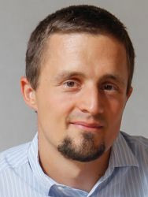
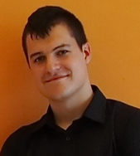

Blockchain@FTSRG
2016 IBM Faculty Award (Prof. Pataricza András)
  Teljesítménymodellezés és –elemzés, Duke kooperáció
Linux Foundation Hyperledger: associate membership
Kocsis Imre: ISO/TC 307 nemzeti delegált
Hyperledger Caliper
Hyperledger Summer Internship-ek (!)
European Institute of Technology (EIT) Professional School: “Blockchain for the decision maker”

Slide 3
A kurzusról
Nem (csak) Bitcoin – Blockchain
  A mai előadás témája
Fő oktatási célok
  Blockchain-ek rendszerszemlélete
  Nem kripto, “Distributed Ledger Technology”
  Alapvető alkalmazási esetek megismerése
  Önálló alkalmazásfejlesztés megalapozása
Választható tárgy; CS/CE csak mértékkel (~)
Tárgykövetelmény: házi feladat

Slide 4
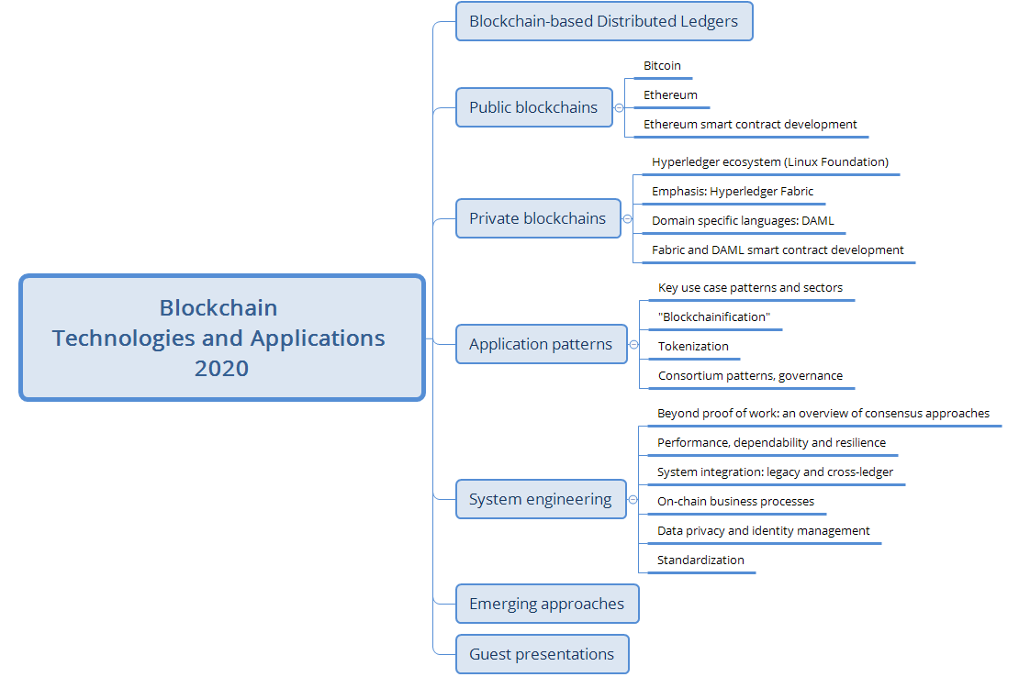
Topics we plan to cover during the course

Slide 5
Distributed ledger Technology

Slide 6
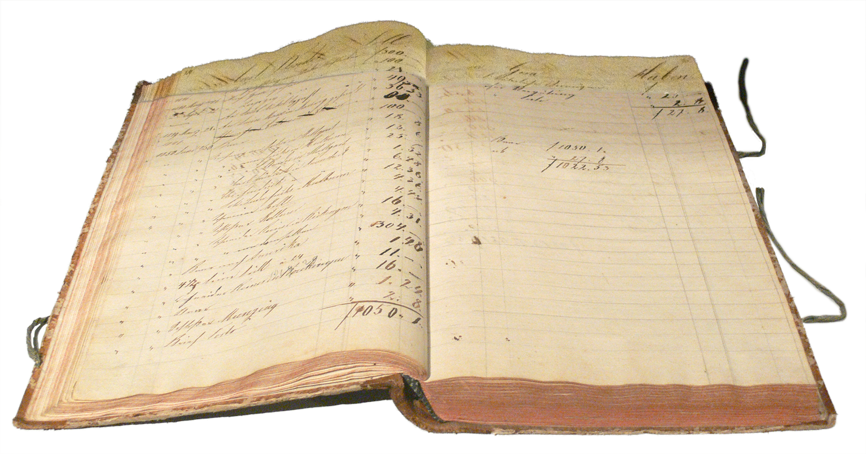
Ledgers
Principal book of account
Records transactions
Append-only
“Checksums”
… but really, just a Tx log based “paper DB”
Based on: https://en.wikipedia.org/wiki/Ledger

Slide 7
Distributed ledgers: eliminating trusted 3rd parties
Centralized
Distributed ledger

Slide 8
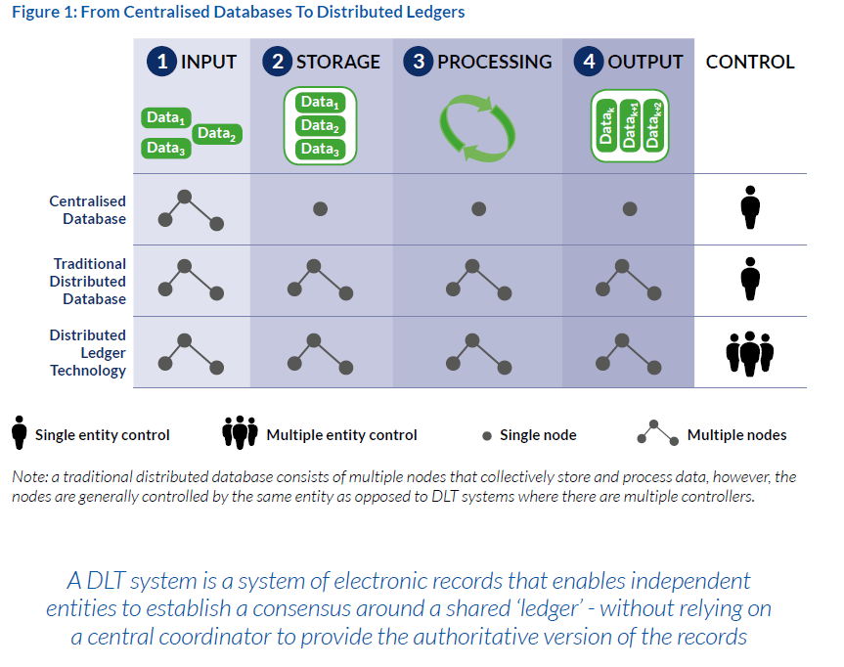
M. Rauchs et al., “Distributed Ledger Technology Systems: A Conceptual Framework,” SSRN Journal, 2018, doi: 10.2139/ssrn.3230013.

Slide 9
Trusted 3rd parties everywhere
Communication: e.g. SWIFT
Marketplaces: exchanges, eBay
Auth. information: DNS, land registry
Risk sharing: insurance
Democracy: election office
…
Your bank account
Good reasons for them; still,
  Centralized trust
  Middlemen have their price
  3rd party making the rules
Leitmotif: “getting rid of the central party” …
but not trust!

Slide 10
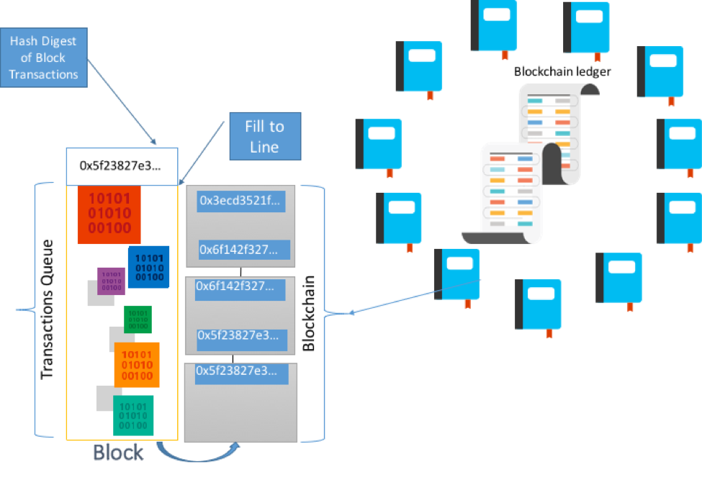
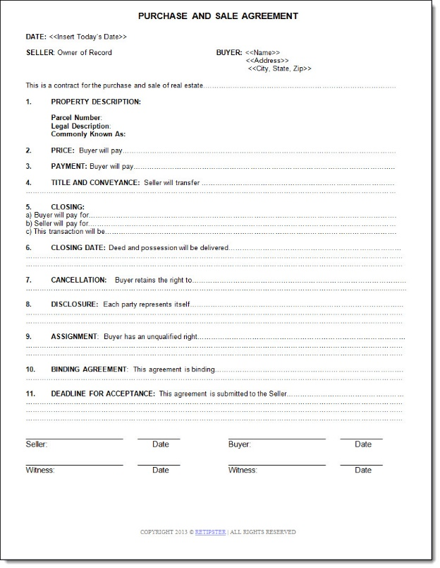
Blockchain technologies: a DLT approach
[1] Source: Marley Gray, Principle Architect PM – Microsoft: Introducing Project Bletchley
Notes:
TBD: source of figure

Slide 11
Replacing the middleman with the group
P2P network of nodes
Each peer: same ledger
  Append-only Tx log
  Hash-chained block list
Group consensus
  On Tx blocks
  While certain % honest
Client != peer
Block
Operation
(Validated)
Block consensus
Block
Operation
(Validated)
Block
Operation
(Validated)
Block consensus

Slide 12
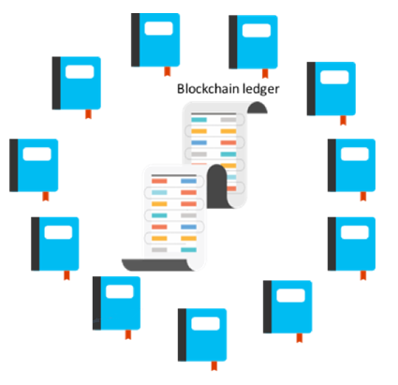
Blockchain properties
Ledger: immutable Tx log; not (just) cryptocurrency!
Smart contracts: programmed Tx logic over ledger state
Shared: across participants
Distributed: replication
Cryptographically authentic: non-repudiable (secure identities), tokenization, signed Txs
Trust: fault/attack tolerant group consensus
Note: these are truly common!

Slide 13


Basic transaction logic
Client request
Order, contract exec result, acceptance: consensus
All ledgers updated
Batch processing < Blockchain latency < hard real-time

Slide 14
But when you peel off the complexity…
Database
Replica DB 1
Replica DB 2
Replica DB 3
Replica DB …
Replica DB …
Replica DB n
C

Slide 15
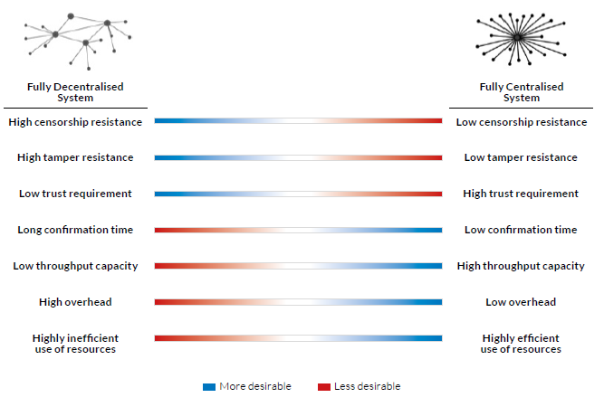
Main differences: extra-functional
!!! Properties to be understood in an “as a rule” manner
M. Rauchs et al., “Distributed Ledger Technology Systems: A Conceptual Framework,” SSRN Journal, 2018, doi: 10.2139/ssrn.3230013.

Slide 16
Same Name, Two(?) Worlds

Slide 17






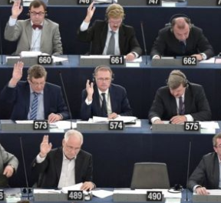

Public vs private/permissioned/consortium/…
 | Network | Participants | Consensus | Transactions
(Bit/alt)coin
Private/ permissioned blockchain
„Not true, but a very, very good lie!”
  (T. Pratchett, Nightwatch)

Slide 18
Some key points
(Cryptocurrency-based) public Blockchains
  Ledger based on some “unit of value”
  Peer honesty incentive: “getting more of that”
    “Mining”, Tx fees + possibly deterrents
  Bitcoin, Ethereum, Monero, Litecoin, …
  Smart contracts
    defined on and
    fueled by cryptocurrency
Private Blockchains
  Ledger: some data model
  Peer honesty
    A&A and real-world ramifications
    Value intrinsic to cooperation
  Smart contract: ledger is essentially a DB
  Hyperledger, Enterprise Ethereum Alliance, Chain Core, …
We discuss all these in detail in later lectures

Slide 19
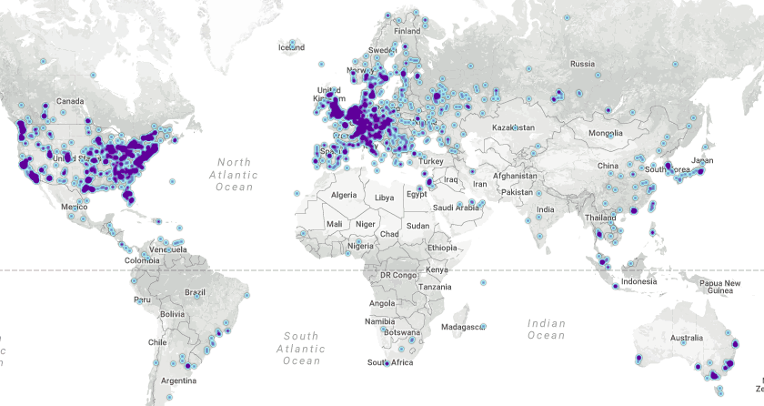

Public example 1: Bitcoin
We fill in the details in the next lecture
Politics, “money” aspects, exchanges, …: coming lectures
“Ground zero” for Blockchains
Ledger: “who” has how many “coins”
P2P network: open, global (but not your closet anymore)
Tx: coin transfers
Client: anybody (pseudonymous!)
New coins: probabilistic, work-proportional peer reward
Figure: bitnodes.21.co

Slide 20
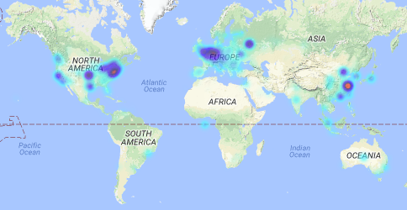

Public example 2: Ethereum
Birds eye view: almost like Bitcoin
“Ether” instead of Bitcoin
But: you can attach code to an account
  Fuel its execution with your crypto-funds
  Have it collect/distribute Ether
  Define your own “token” in a contract
Figure: ethernodes.org

Slide 21
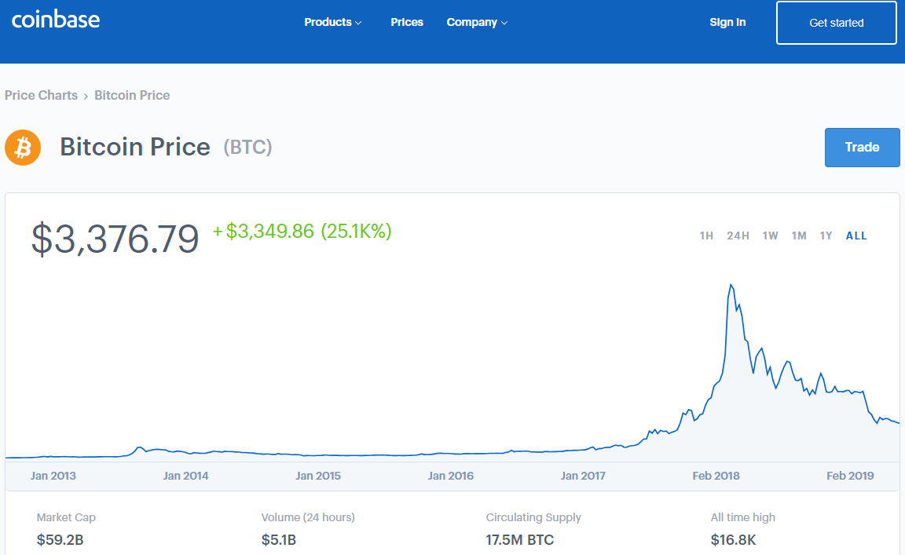
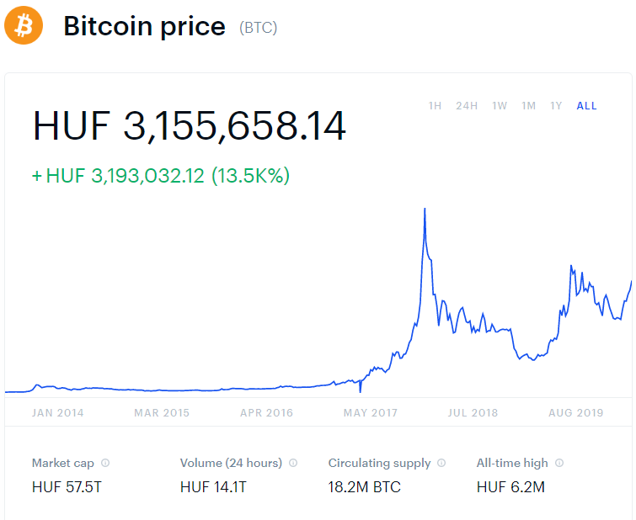
Slight detour: Bitcoin price
And suddenly…

Slide 22
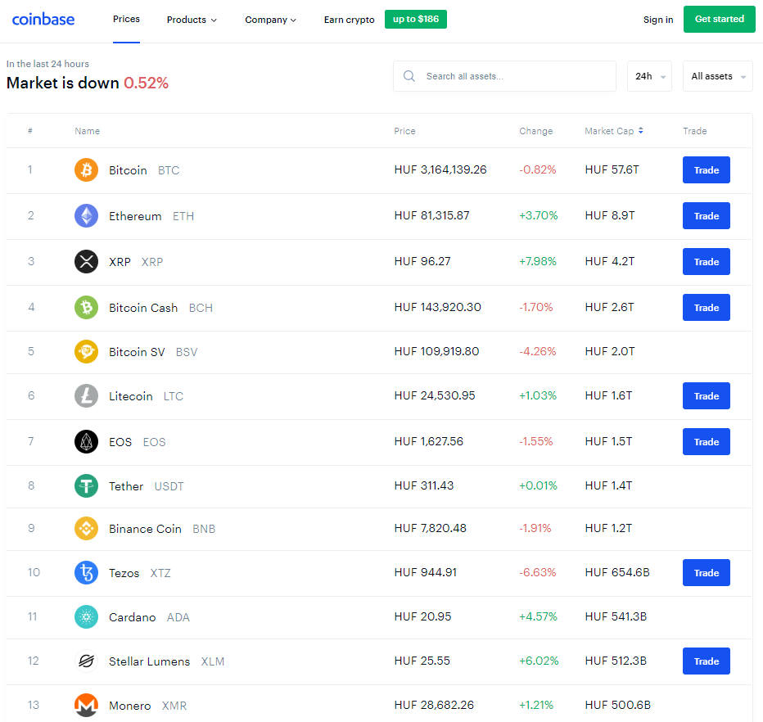

Slide 23
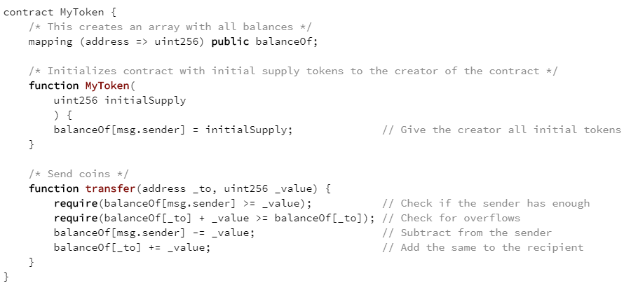
Ethereum: the very basics of token mechanics
You pay a little Ether for function calls
But can also sell the token
Contract state and logic “is your business”

Slide 24
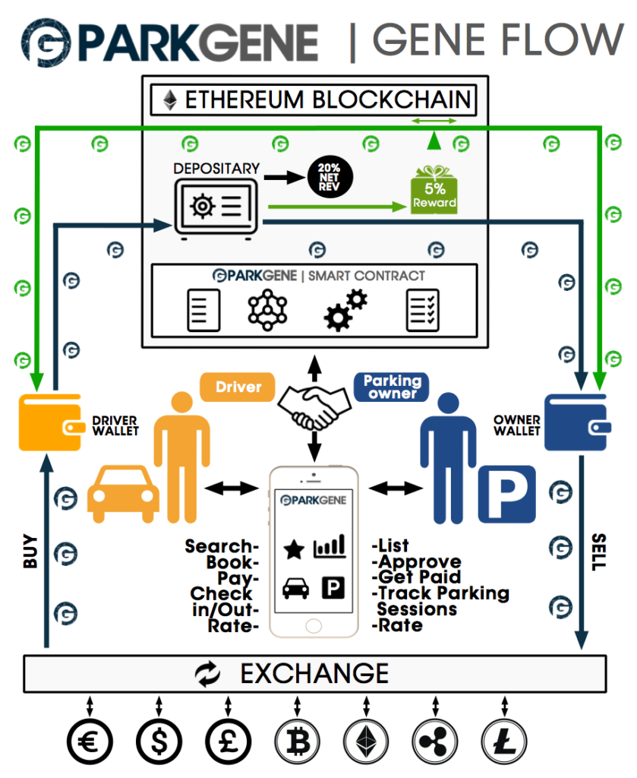
Some Ethereum smart contracts
Source: https://parkgene.io/

Slide 25
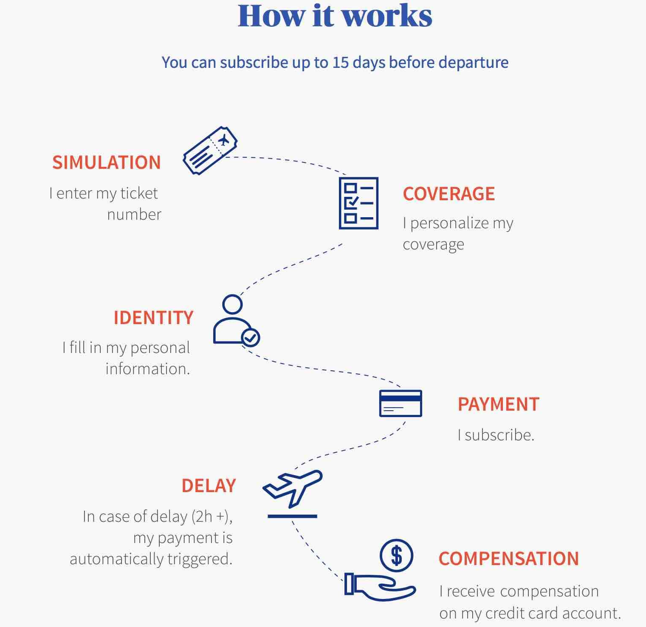
Some Ethereum smart contracts
On-chain, “programmed” claim assessment
Long, closed, manual process transformed into transparent automatism
Ethereum
  Privacy?
But: risk ownership and management not crowd/consortium-sourced
  Could be; many startups!
Claim assessment is “only” automated, too
Source: https://fizzy.axa/

Slide 26
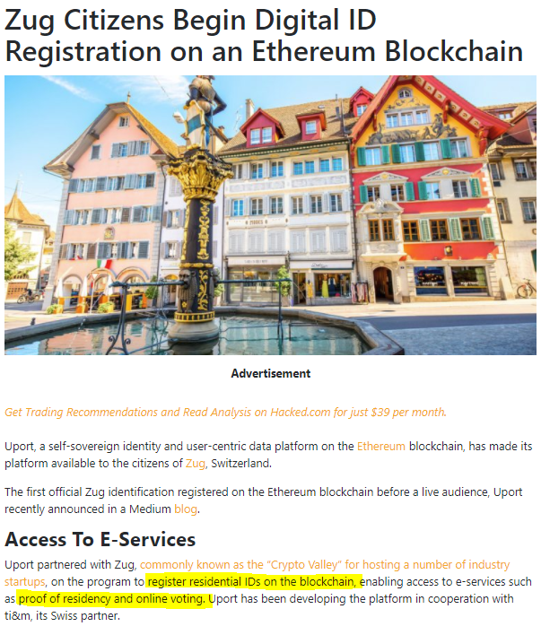

Slide 27
Ethereum
Decentralized autonomous organizations?
  Well… We will talk about the DAO hack
ICO: “buying into” an idea
  Business share, stake, right to use, …
Many “Initial Coin Offerings” are (were) scams
Look around!
  https://icotracker.net/
  http://www.icocountdown.com/
  …

Slide 28

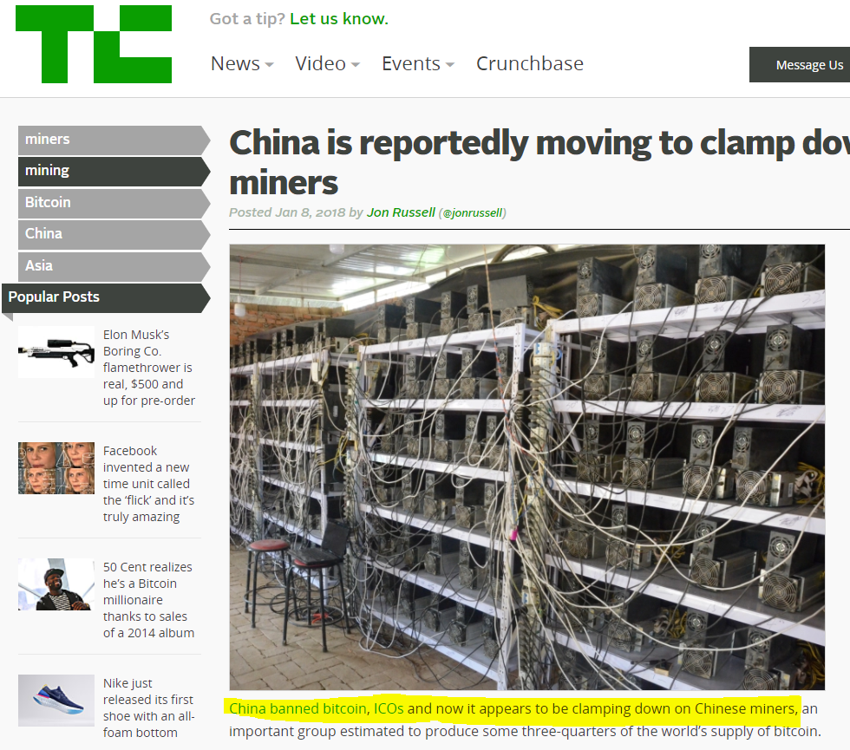
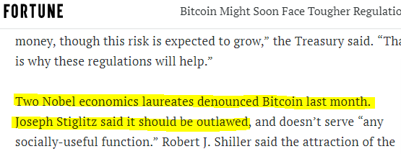
Cryptocurrencies: uncertain future
On the other hand: DLT enjoys universal support.

Slide 29
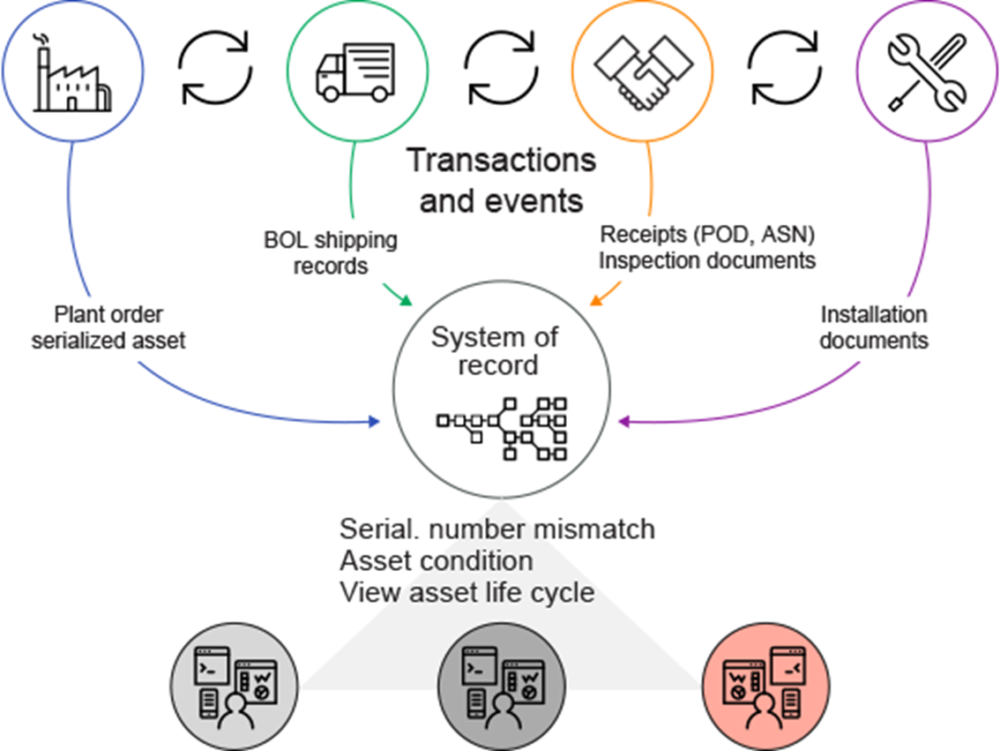
Private Blockchains: asset/supply management
“Small”, closed network
Peer + client A&A
“Weighted” voting
Arbitrary Tx logic
These are intended!
You can have (asset) tokens
But don’t have to
Ábra: IBM: Adopting Blockchain for enterprise asset management (EAM)

Slide 30
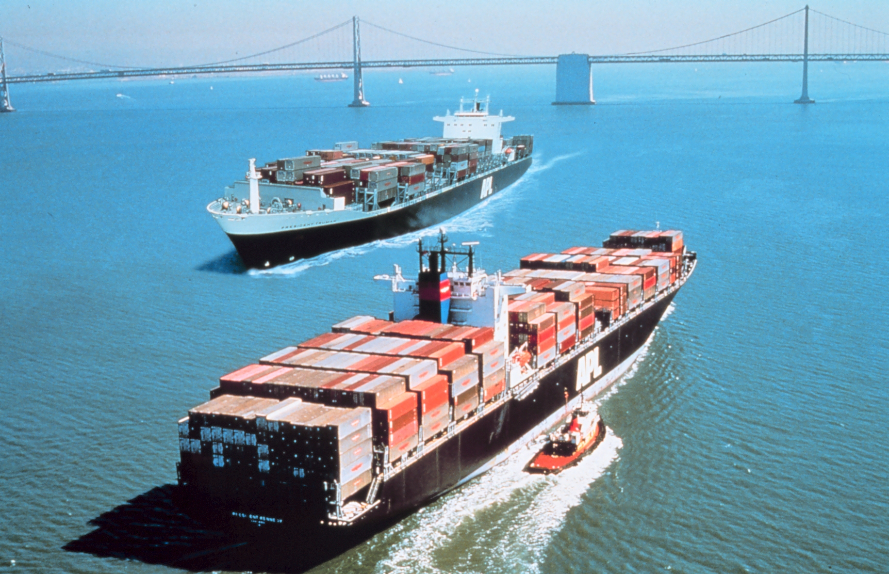
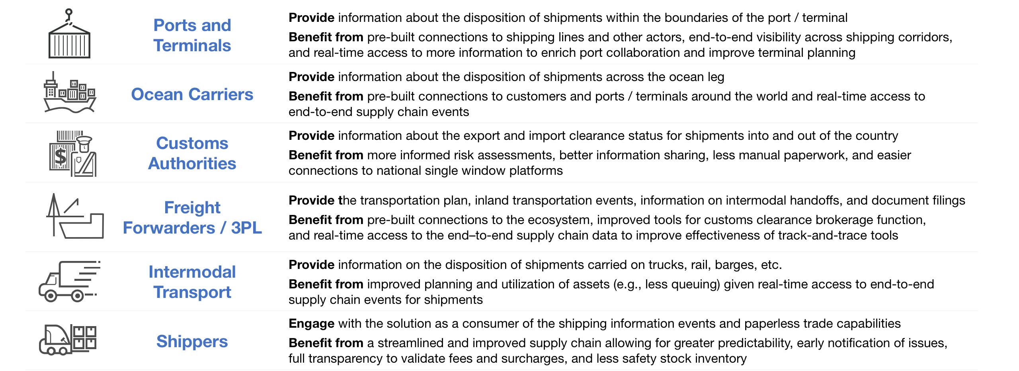
A success story: MAERSK and IBM
Both examples over Hyperledger fabric (Linux Foundation)
Source: https://www.ibm.com/blogs/blockchain/2018/01/digitizing-global-trade-maersk-ibm/

Slide 31
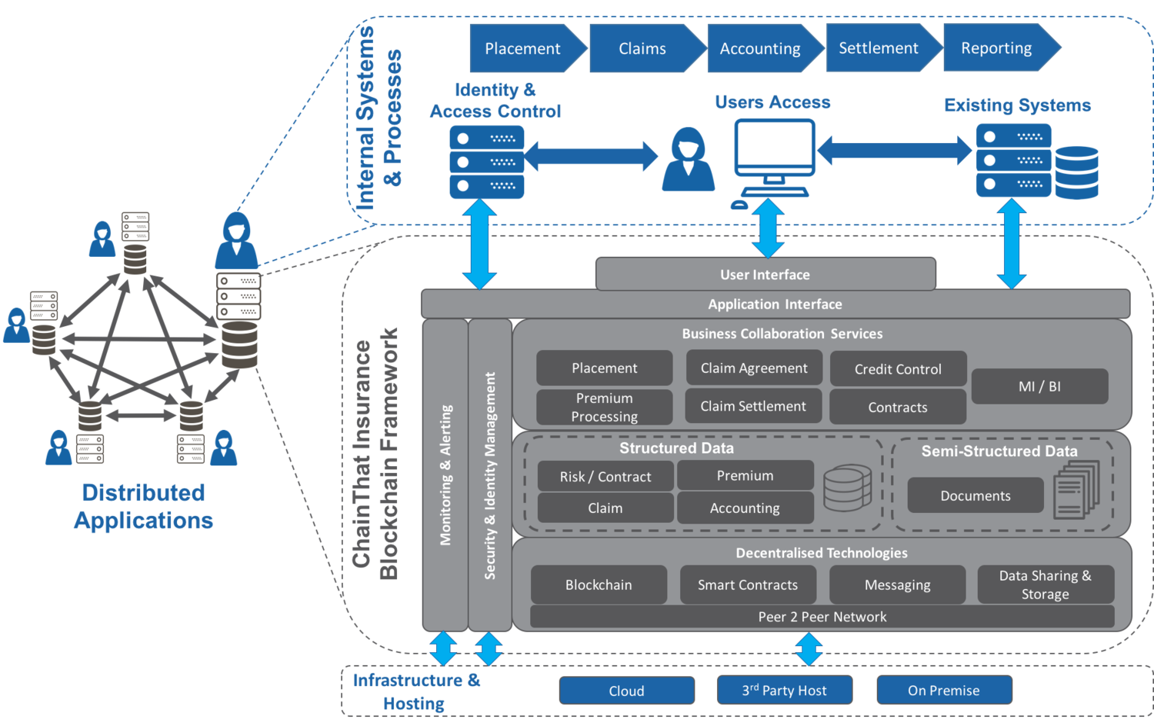
Closed markets: reinsurance
Smart contract is an important, but small part!
http://www.chainthat.com/framework/

Slide 32
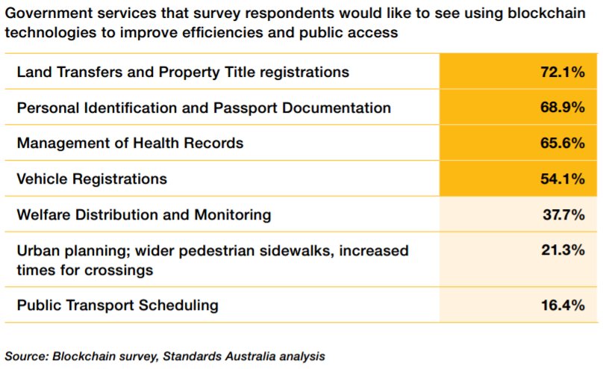
Not only enterprise/business!
Note: it is situational, whether the public or private model fits better

Slide 33
Egy teljesebb taxonómia
E.g., Conseil National des Greffiers des Tribunaux de Commerce:
Francia cégbejegyzések tartományok között koordinált kezelése
Zárt/”konzorciális”/”privát” hálózat
Sok, testreszabott “üzleti” hálózat
Hyperledger, Quorum, …
https://wiki.hyperledger.org/display/PSSIG/Public+Sector+SIG
Szabad részvétel a konszenzusban (permissionless)
Jogosult csomópontok, szavazás-szerű (perm’d)
Energy Web Chain
Ripple
“Néhány” világméretű hálózat
“Mining” et al. helyett – 15+ éves protokollok
Bitcoin, Ethereum, Zcash, …
“Kripto”: tx díj + “ha kell”
Libra?
“Kriptopénz” léte elkerülhetetlen
Publikus hálózat

Slide 34
Digital assets and Tokenization

Slide 35
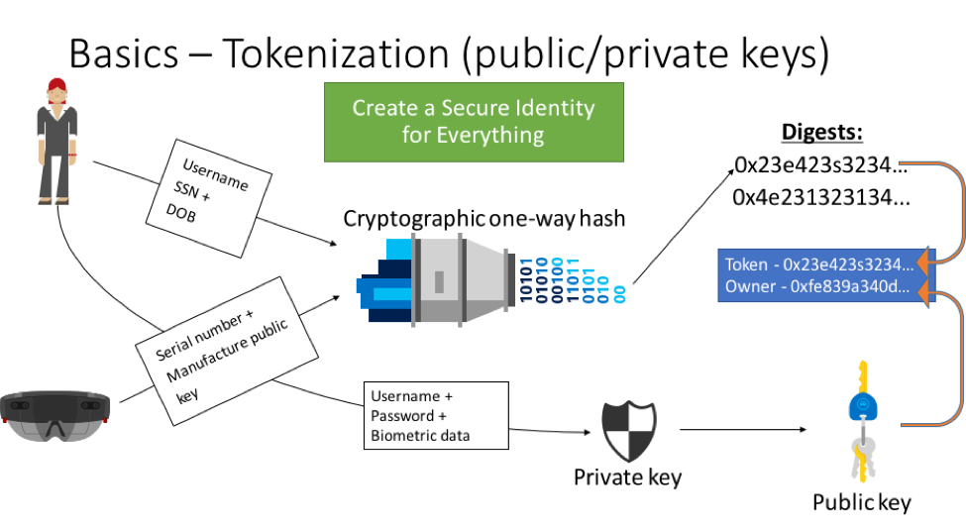
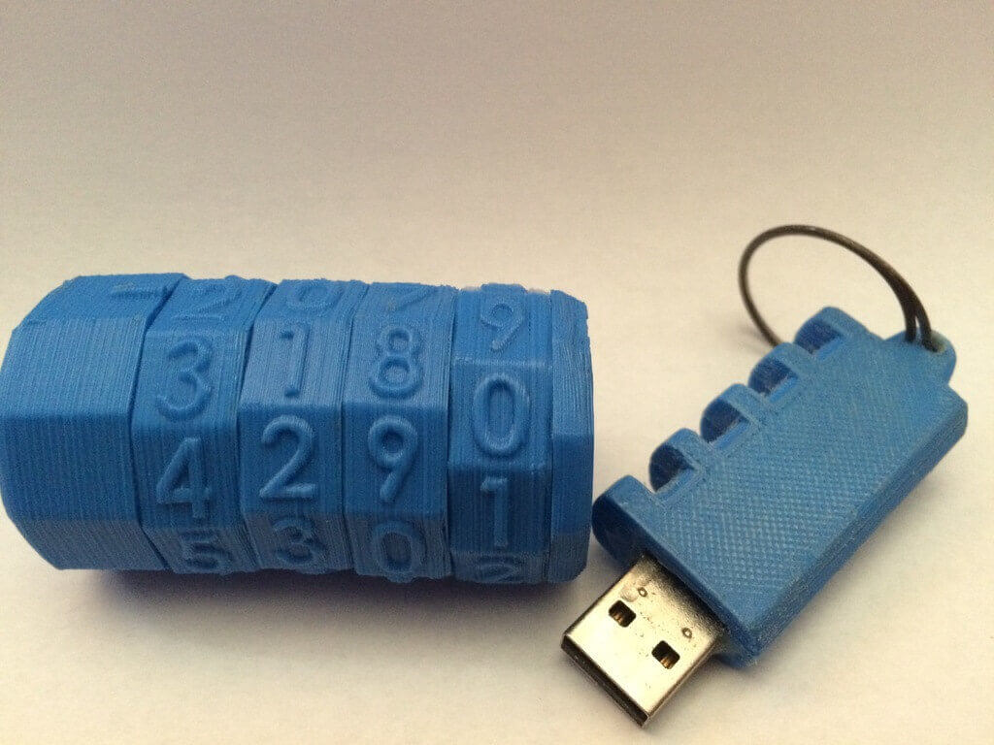
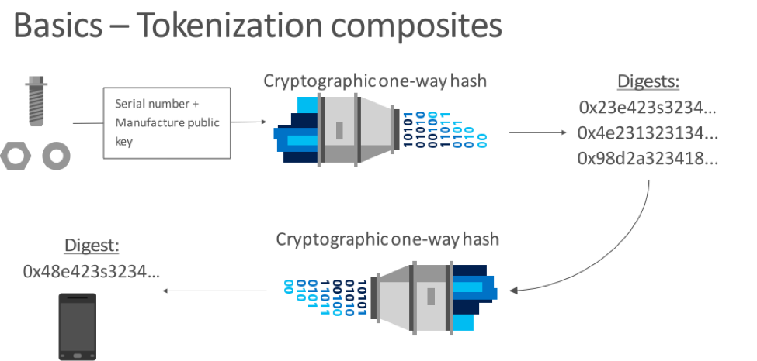
Cryptographic tokenization of assets
Source: Introducing Project "Bletchley" Marley Gray, Principle Architect PM - Microsoft - Azure Blockchain Engineering

Slide 36
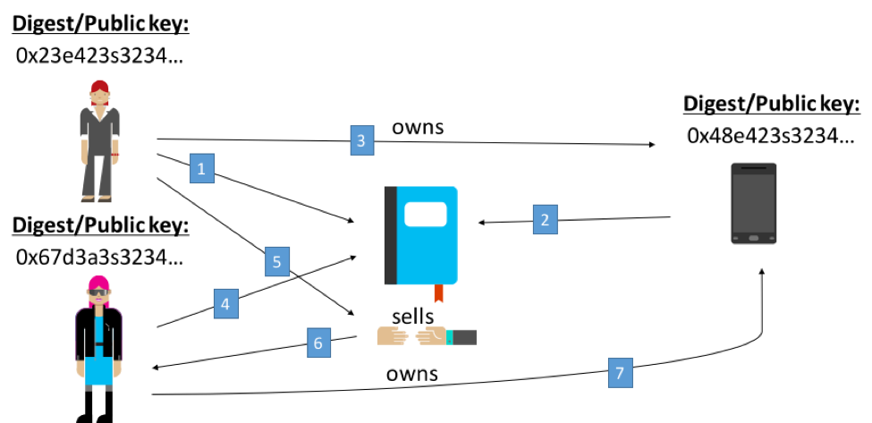
Smart contracts over tokenized assets
Source: Introducing Project "Bletchley" Marley Gray, Principle Architect PM - Microsoft - Azure Blockchain Engineering

Slide 37
But what do you put on the ledger?
Tracking the ownership of money
  Cryptocurrency is actually a special case
  Could be even fiat
Tracking the ownership/status of assets
  Physical, logical, financial
  Cryptographic tokenization
But you can use it as a database, too
Changes will be ruled by smart contracts
We will demonstrate these concepts as we progress

Slide 38
Some digital asset types
Cryptocurrency
Central bank currency
Digital currency
Commodity-backed tokens
Equity tokens
Accounting tokens
Digital collectible
Utility tokens
https://www.coindesk.com/periodic-table-blockchain-classify-tokens/

Slide 39
The Fourth
Industrial Revolution?

Slide 40
Industrial revolutions
1st: urbanization, steam engine
2nd: steel, oil, electricity, internal combustion engine
3rd: digitization, ICT, Internet
4th: technology embedded within societies
  DLT is identified as a key component
We’ve never had this capability before – trusted transactions directly between two or more total strangers, authenticated by mass collaboration, and powered by collective self-interests, rather than by corporations motivated by profit or governments motivated by power.
Source: World Economic Forum: Realizing the Potential of Blockchain, June 2017.
Notes:
Realizing the Potential
of Blockchain

Slide 41
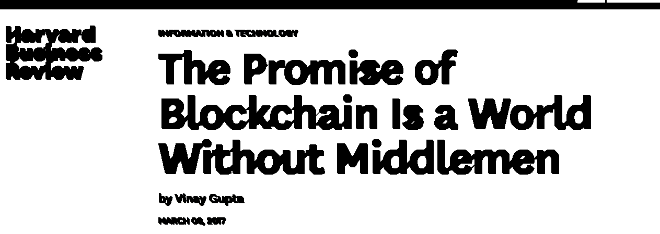

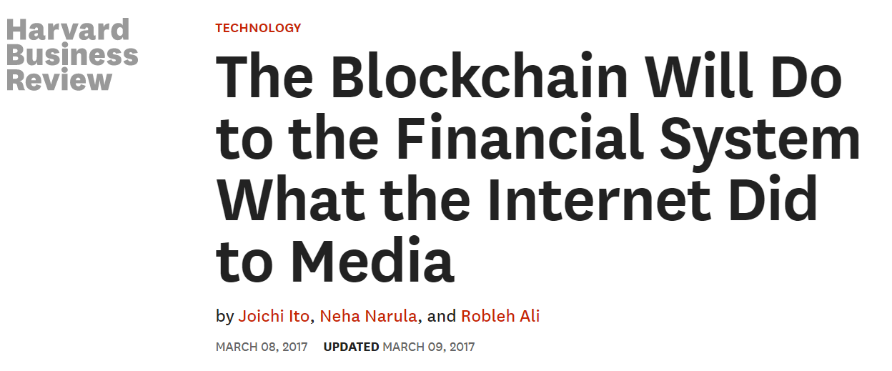

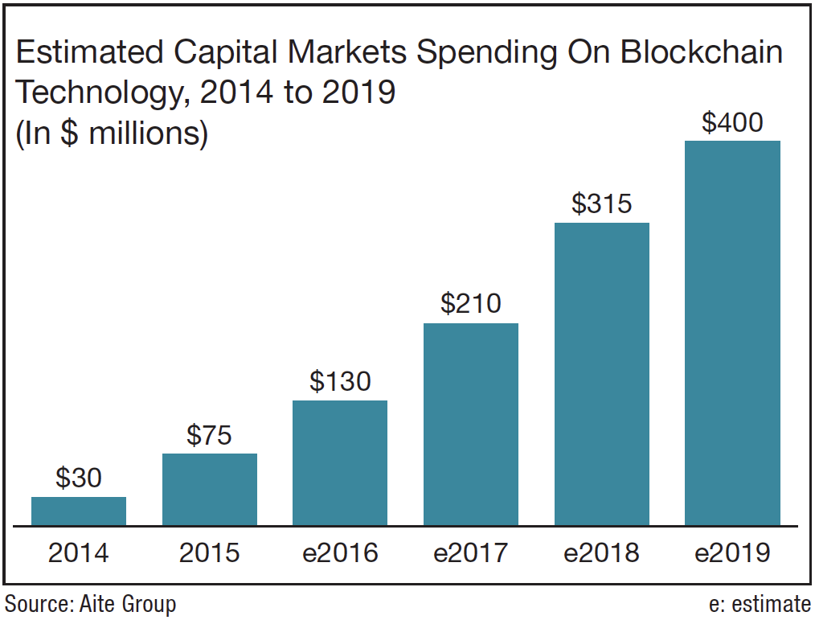
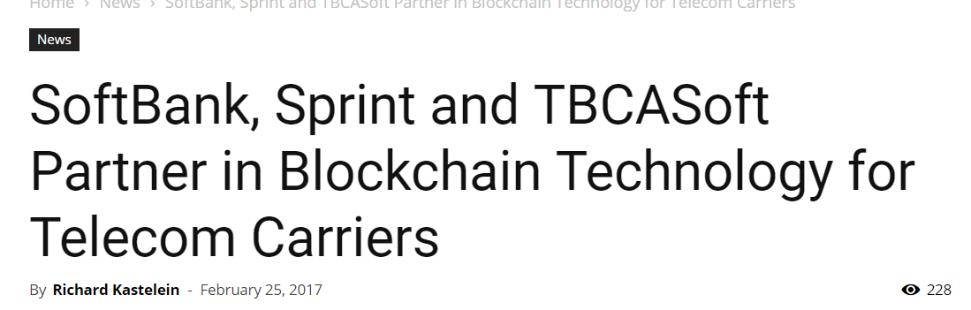
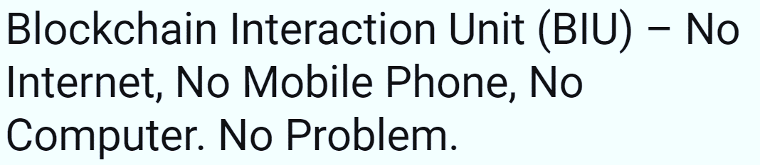

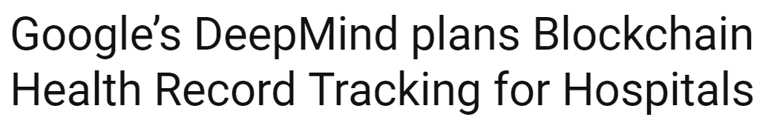
2017: “A rapidly emerging sector”

Slide 42
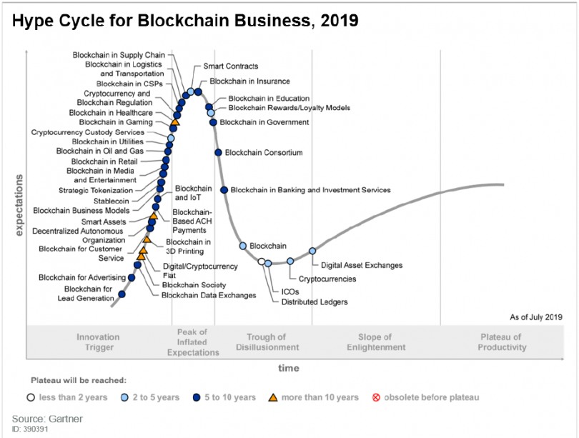

Slide 43
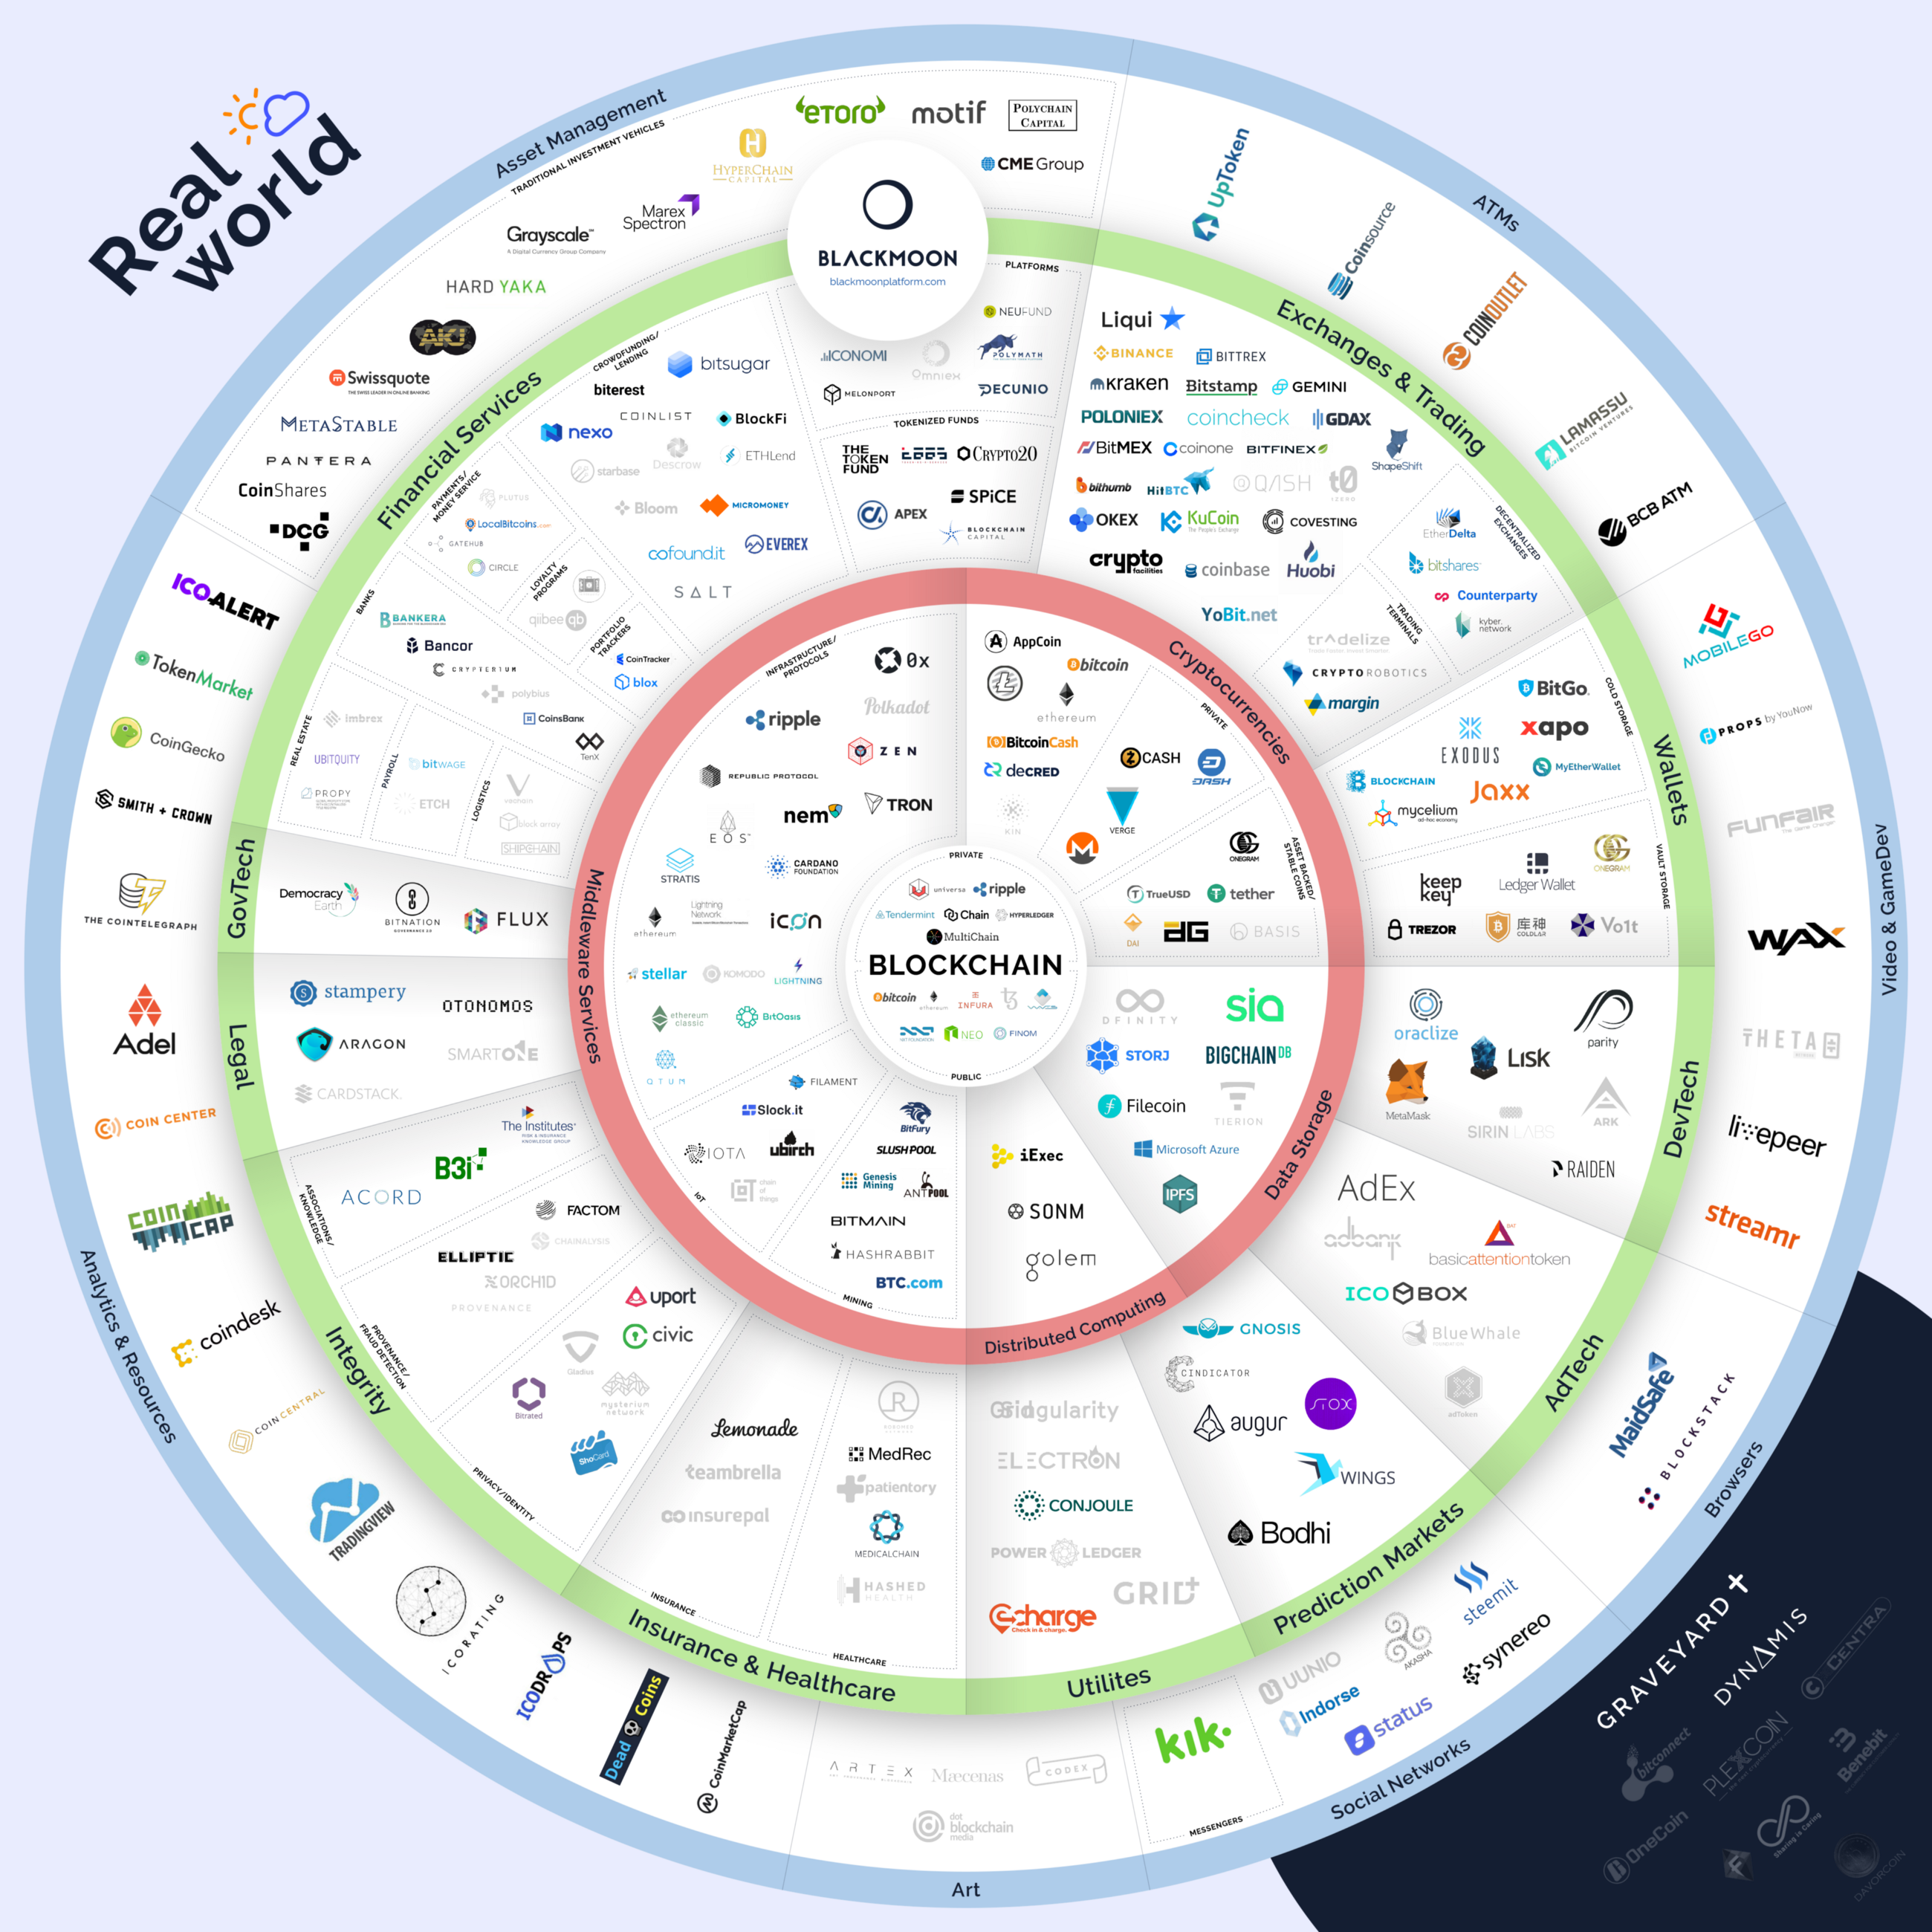
Blockchain project ecosystem
https://news.blackmooncrypto.com/
the-blockchain-ecosystem-v3-six-months-
after-the-hype-ca14e9879001

Slide 44
A Note on Performance

Slide 45
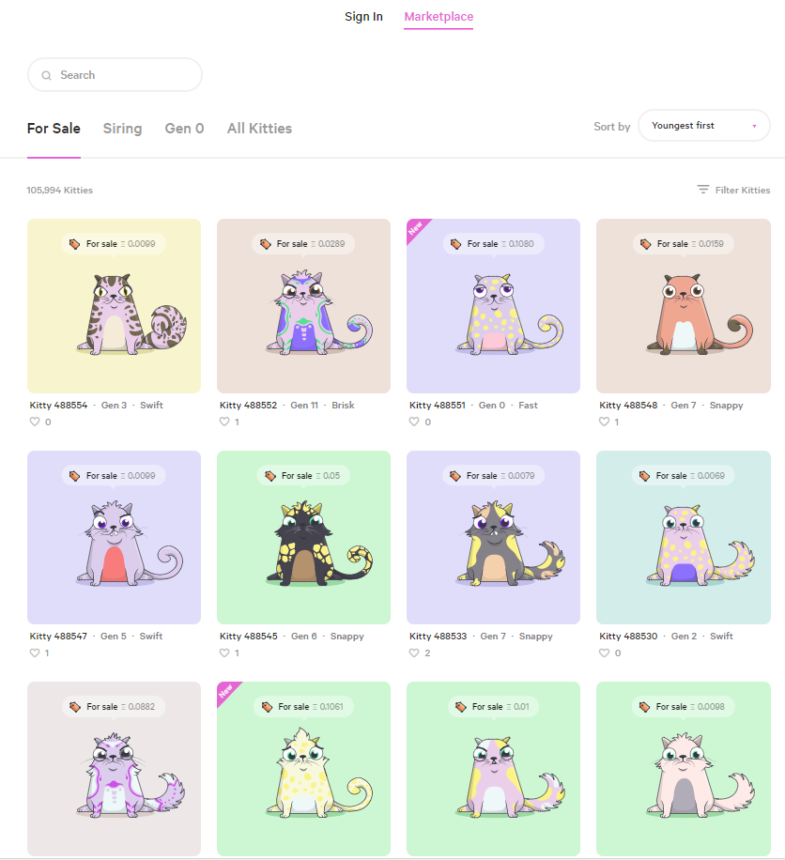
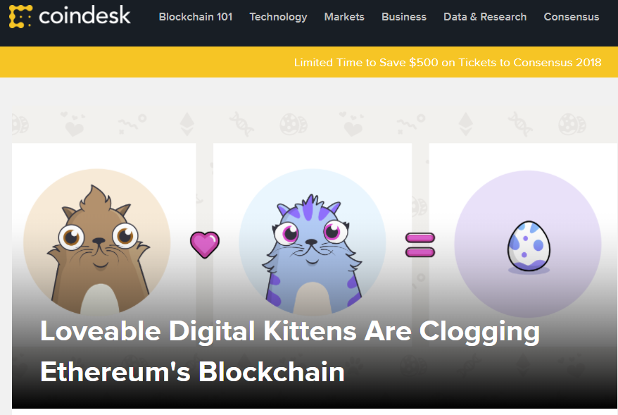
CryptoKitties! ☺☹

Slide 46
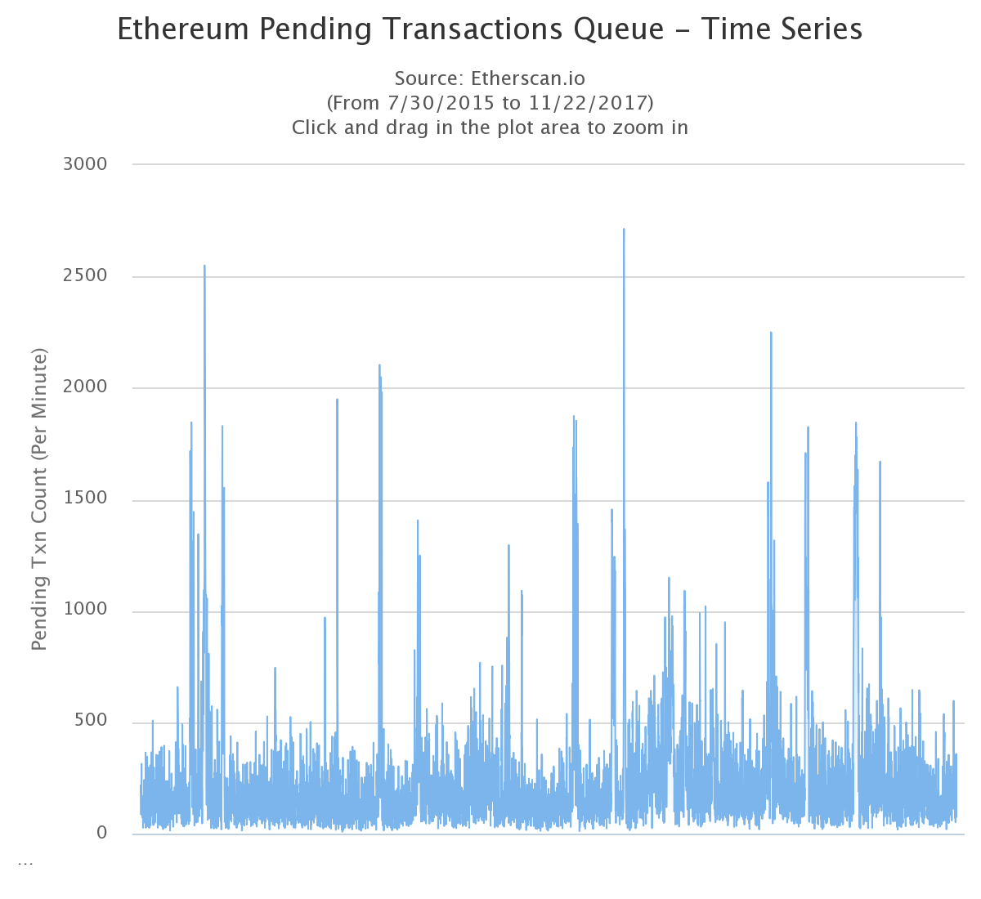
Public Blockchain: performance
Throughput
Latency: variance
Price: variance

Slide 47
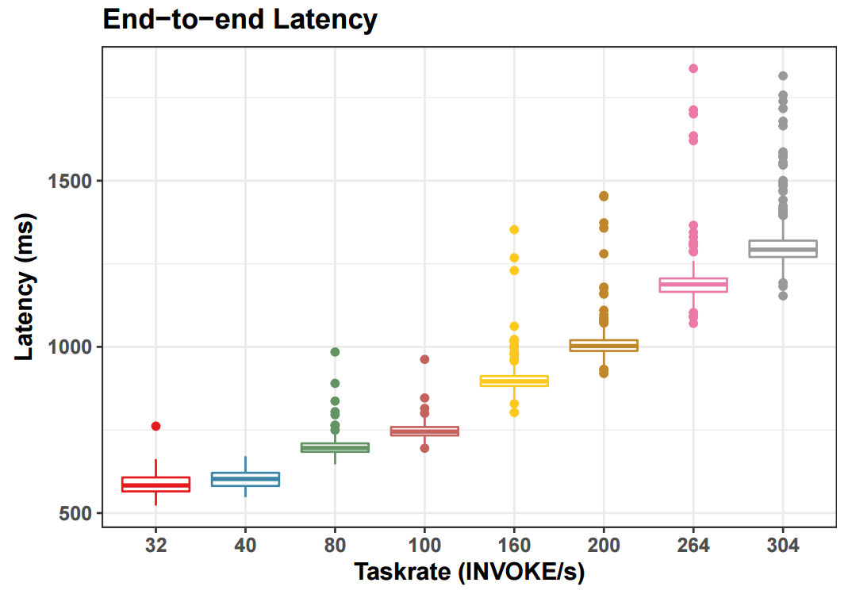
Private Blockchain performance
HL fabric v0.6
Due to blocks: still latency and size limits, but
Tunable
Plannable
Protectable
v1.x: 3000 Tps and beyond

Slide 48
Topics we plan to cover during the course

